Slide 1
Place Suggesting Intelligent Bot
Supervisor
Team Members
Kiều Trọng Khánh
Huỳnh Thành Đạt – SE61273 (Leader)
Trương Châu Minh Huy – SE61175
Trần Văn Thành – SE61373
Đào Công Thuận – 60487

Slide 2
 Overview
Problems
Our Proposal
Feature Explanation
Natural Language Processing & Training
Data Diversification
Nearby Algorithm
Manage Log
Additional Feature
Advantage/ Disadvantage
Future plan

Slide 3

PROBLEMS
Place Suggestion Intelligent Bot

Slide 4
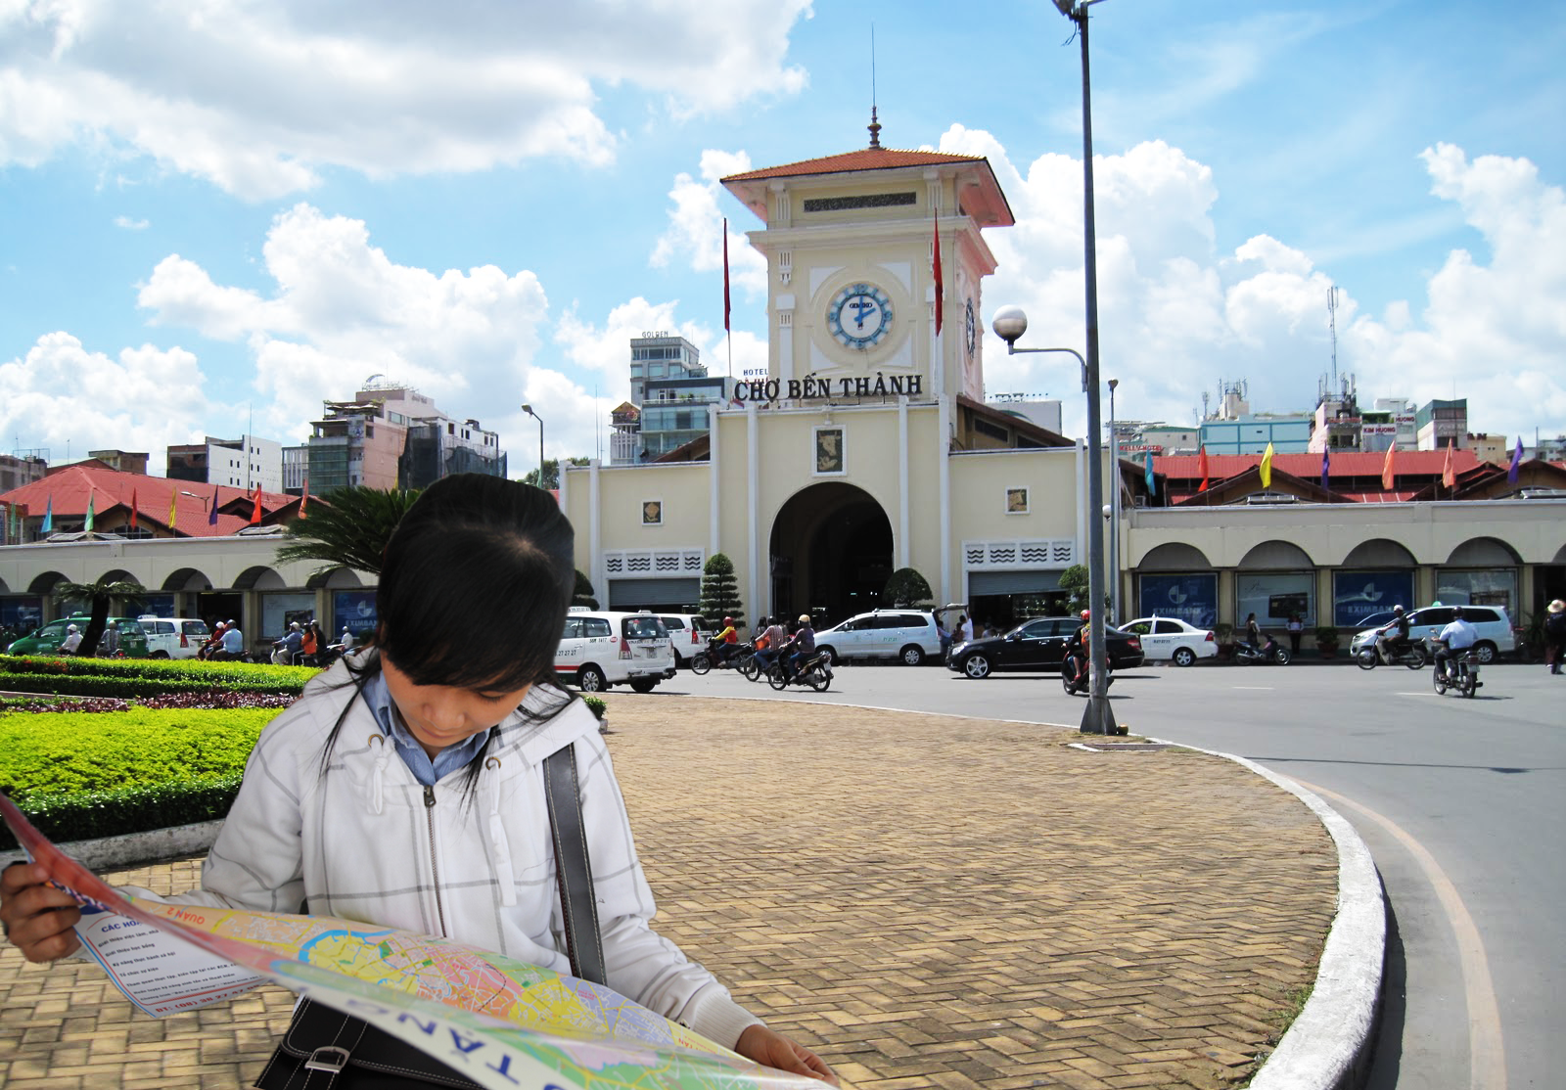
 Problem

Slide 5
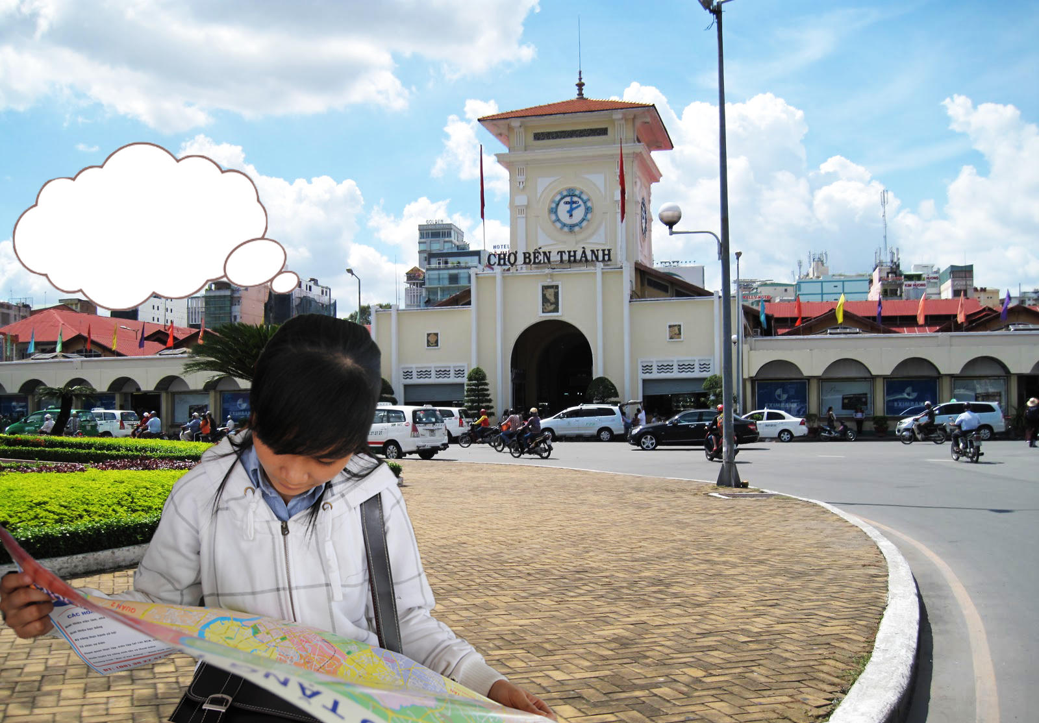
 Problem
Ăn phở ở đâu ngon nhỉ?

Slide 6

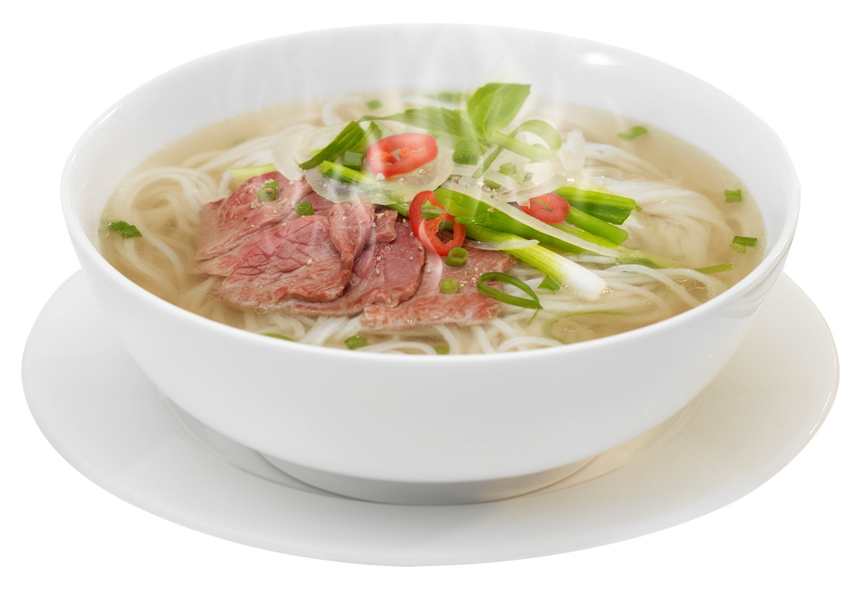
 Problem – Google Search
Keyword:

Slide 7
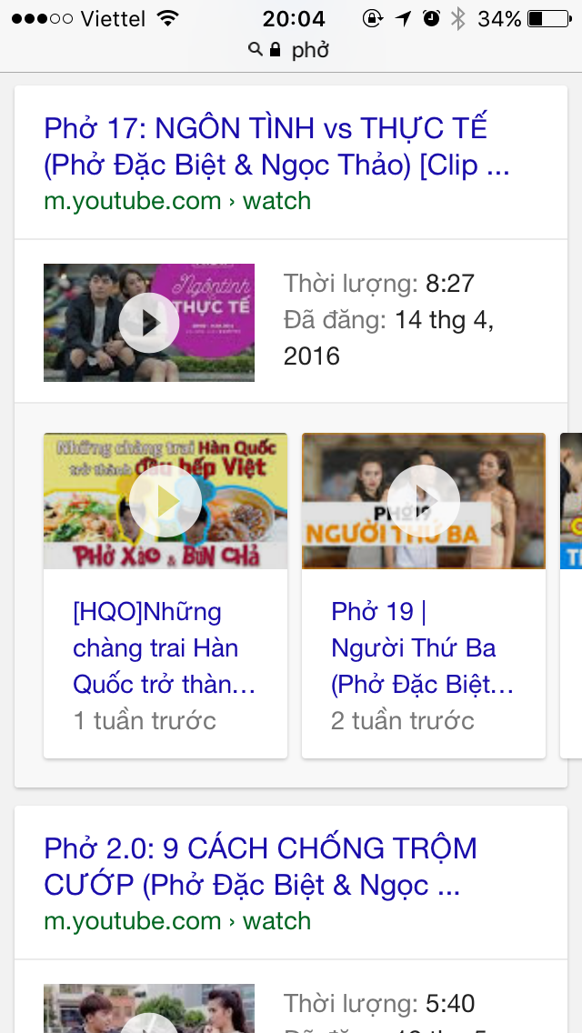
 Problem – Google Search
Keyword:

Slide 8
 Problem – Google Search
Keyword:

Slide 9
 Problem – Google Search
Keyword:

Slide 10
 Problem – Google Search
Keyword:

Slide 11
 Problem – Google Search
Keyword:

Slide 12

 Problem – Google Search
Keyword:

Slide 13
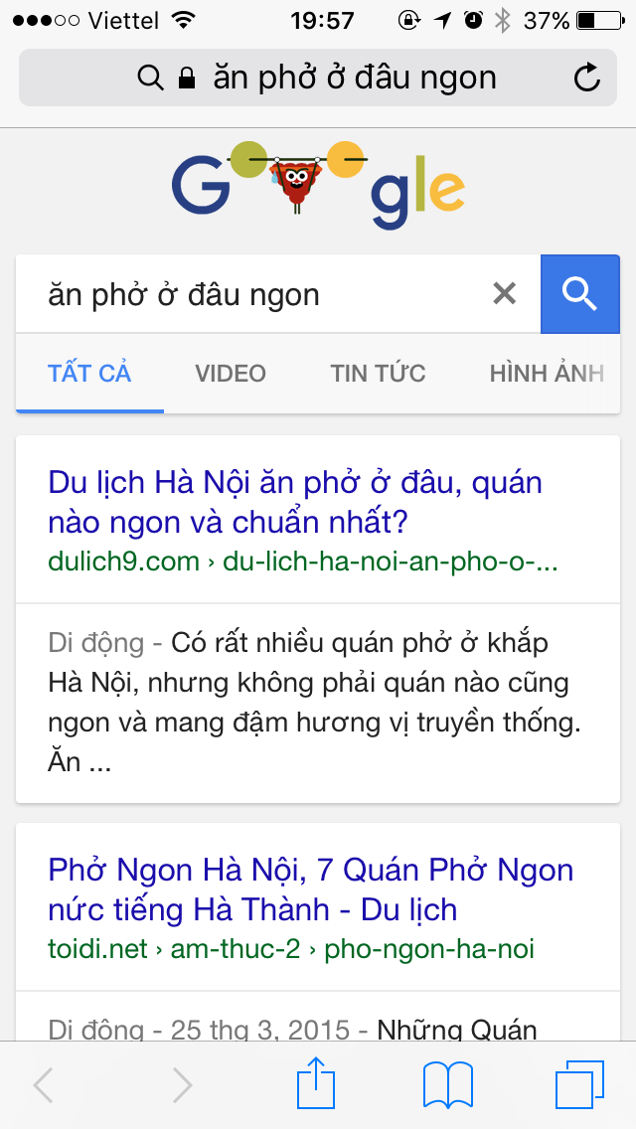
 Problem – Google Search
Keyword:

Slide 14
 Problem – Google Search
Keyword:

Slide 15
 Problem – Google Search
Keyword:

Slide 16
 Problem – Google Search
Keyword:

Slide 17

 Problem – Google Search
Keyword:

Slide 18
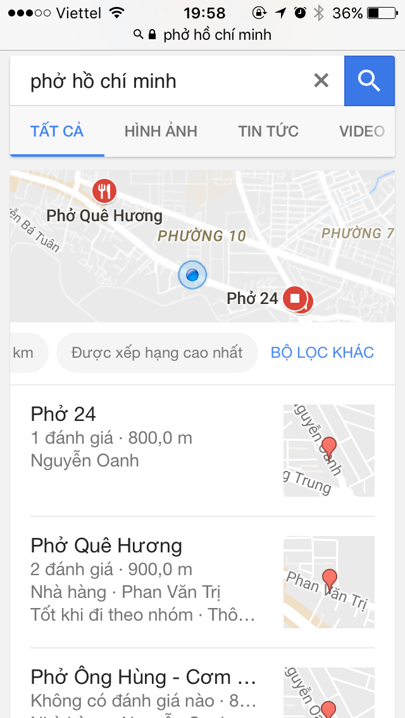
 Problem – Google Search
Keyword:

Slide 19
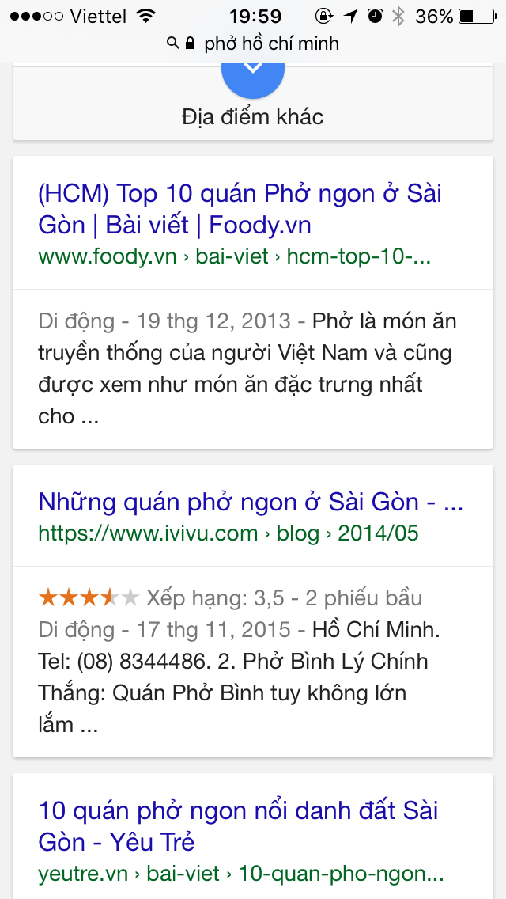
 Problem – Google Search
Keyword:

Slide 20


 Problem – Google Search
?
Keyword:

Slide 21
 Problem – Google Search
Advantages

Slide 22
 Problem – Google Search
Advantages
✓ Returns results quickly.

Slide 23
 Problem – Google Search
Advantages
✓ Returns results quickly.
✓ Diversity of information sources.

Slide 24
 Problem – Google Search
Disadvantages
✘ Difficult to find exactly keywords
Notes:
Thiếu: có keyword chính xác (đầu tiên)

Slide 25
 Problem – Google Search
Disadvantages
✘ Difficult to find exactly keywords
✘ Difficult to identify reliable sources
Notes:
Thiếu: có keyword chính xác (đầu tiên)

Slide 26
 Problem – Google Search
Disadvantages
✘ Difficult to find exactly keywords
✘ Difficult to identify reliable sources
✘ Difficult to determine the accuracy of the information at the time of the search
Notes:
Thiếu: có keyword chính xác (đầu tiên)

Slide 27

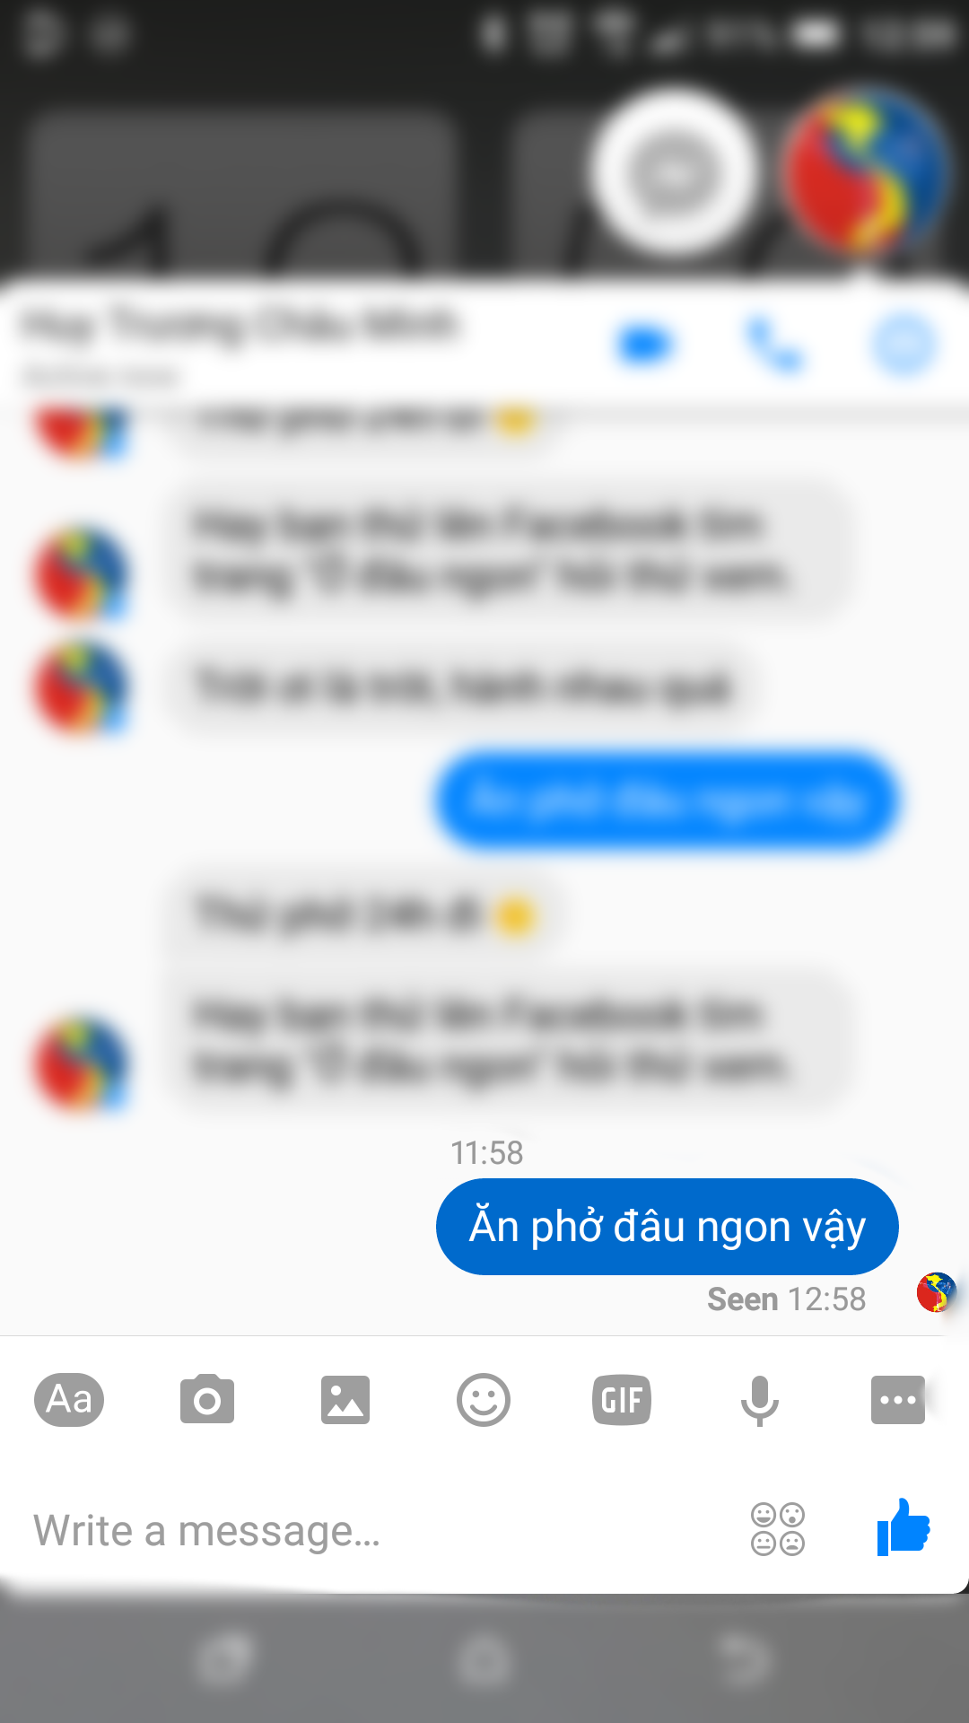
 Problem – Facebook ask friend

Slide 28
 Problem – Facebook ask friend
.

Slide 29
 Problem – Facebook ask friend
..

Slide 30
 Problem – Facebook ask friend
…

Slide 31
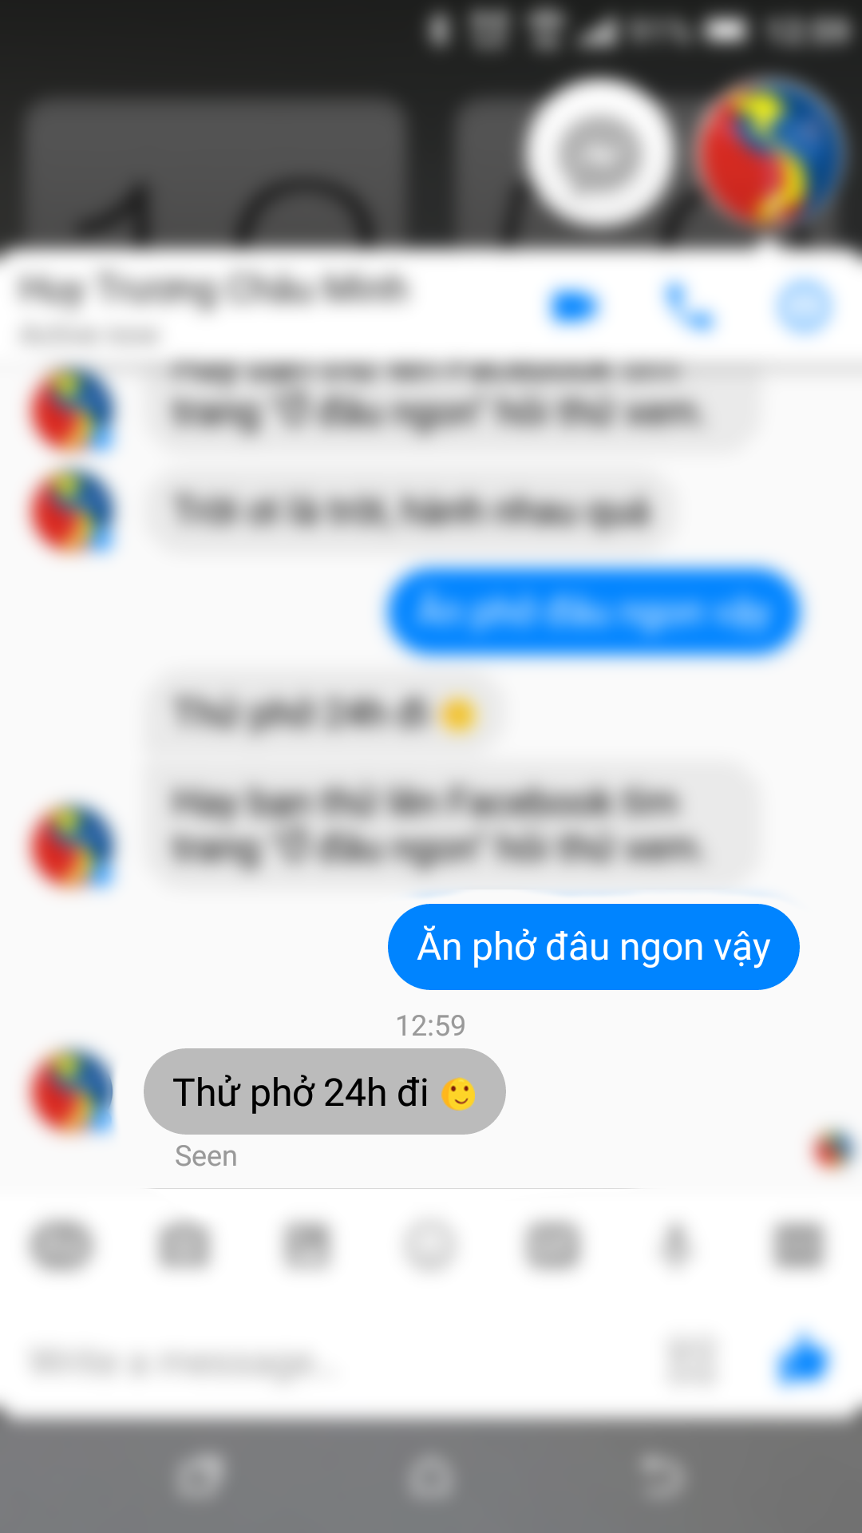
 Problem – Facebook ask friend

Slide 32

 Problem – Facebook ask friend

Slide 33
 Problem – Facebook ask friend
Advantages
✓ Many friends use Facebook

Slide 34
 Problem – Facebook ask friend
Advantages
✓ Many friends use Facebook
✓ Easy to make conversation.

Slide 35
 Problem – Facebook ask friend
Disadvantages
✘ Do not know the time when friends answer the question

Slide 36
 Problem – Facebook ask friend
Disadvantages
✘ Do not know the time when friends answer the question
✘ Sometimes get unexpected answers

Slide 37

 Problem – Facebook ask friend

Slide 38

 Problem – Facebook ask friend

Slide 39
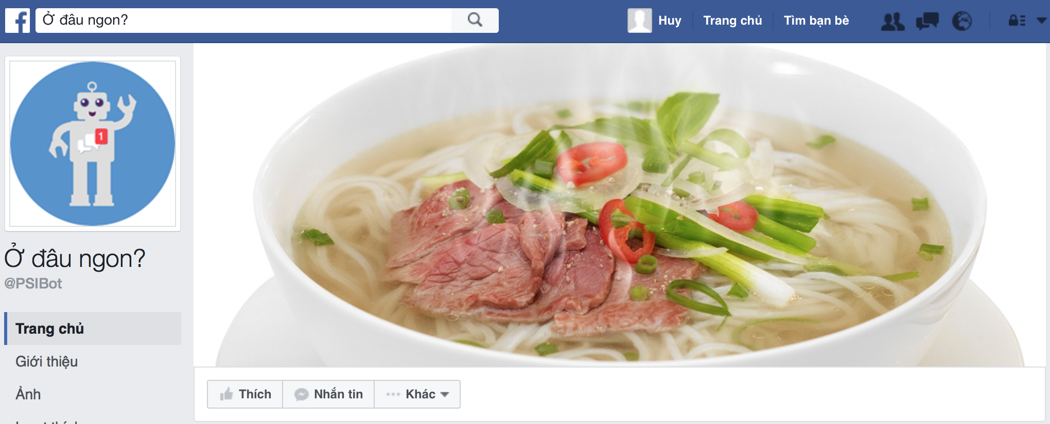
Place Suggesting Intelligent Bot
Notes:
Dua tren nhung van de da neu tren, nhom chung toi quyet dinh dua ra mot he thong bao gom cac phan sau
Ghi trên slide, đưa hình ảnh của bot mình
“xin giới thiệu quý hội đồng hệ thống của chúng tôi…..”

Slide 40
This is OUR PROPOSAL
Place Suggesting Intelligent Bot
Notes:
Dua tren nhung van de da neu tren, nhom chung toi quyet dinh dua ra mot he thong bao gom cac phan sau
Ghi trên slide, đưa hình ảnh của bot mình
“xin giới thiệu quý hội đồng hệ thống của chúng tôi…..”

Slide 41
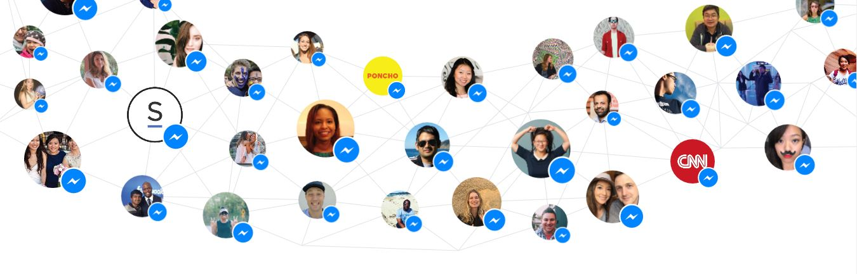

 Technology
An easy way to message
Notes:
April 13 Facebook launch Messenger

Slide 42
 Technology
An easy way to message
Live Messaging
Notes:
April 13 Facebook launch Messenger

Slide 43
 Technology
An easy way to message
Live Messaging
Provide quick access
Notes:
April 13 Facebook launch Messenger

Slide 44
 Technology
An easy way to message
Live Messaging
Provide quick access
Notes:
April 13 Facebook launch Messenger

Slide 45

 Technology
An easy way to message
Live Messaging
Provide quick access
Notes:
April 13 Facebook launch Messenger

Slide 46
 Technology
An easy way to message
Live Messaging
Provide quick access
Notes:
April 13 Facebook launch Messenger

Slide 47

 Technology
An easy way to message
Live Messaging
Provide quick access
Notes:
April 13 Facebook launch Messenger

Slide 48
 Technology
An easy way to message
Live Messaging
Provide quick access
Notes:
April 13 Facebook launch Messenger

Slide 49

 Technology
An easy way to message
Live Messaging
Provide quick access
Webhook
Notes:
April 13 Facebook launch Messenger

Slide 50

 Our proposal – For facebook Users
Facebook Users

Slide 51
 Our proposal – For facebook Users
(1) Ask product
Facebook Users
Facebook Messenger

Slide 52
 Our proposal – For facebook Users
(1) Ask product
(2) Send request
Facebook Users
Facebook Messenger

Slide 53
 Our proposal – For facebook Users
(1) Ask product
(2) Send request
Facebook Users
Facebook Messenger
PSIB Engine

Slide 54
 Our proposal – For facebook Users
(1) Ask product
(2) Send request
Facebook Users
(3) Response
Facebook Messenger
PSIB Engine

Slide 55
 Our proposal – For facebook Users
(1) Ask product
(2) Send request
Facebook Users
(4) Response
(3) Response
Facebook Messenger
PSIB Engine
Notes:
Tô đậm PSIB – My system – Proposal

Slide 56
 Our proposal – For facebook Users
(1) Ask product
(2) Send request
Facebook Users
(4) Response
(3) Response
Facebook Messenger
PSIB Engine
Notes:
Tô đậm PSIB – My system – Proposal

Slide 57
 Our proposal – For facebook Users
(1) Ask product
(2) Send request
Facebook Users
(4) Response
(3) Response
Facebook Messenger
PSIB Engine
This is our PROPOSAL
Notes:
Tô đậm PSIB – My system – Proposal

Slide 58
FEATURE EXPLANATION
Place Suggesting Intelligent Bot
Notes:
Dua tren nhung van de da neu tren, nhom chung toi quyet dinh dua ra mot he thong bao gom cac phan sau

Slide 59
Natural Language Processing & Training
Place Suggestion Intelligent Bot

Slide 60

 Natural Language Processing
Notes:
April 13 Facebook launch Messenger

Slide 61

 Natural Language Processing
Notes:
April 13 Facebook launch Messenger

Slide 62

 Natural Language Processing

Slide 63
 Natural Language Processing
a natural language
understanding platform

Slide 64
 Natural Language Processing
Conversation Management
a natural language
understanding platform

Slide 65
 Natural Language Processing
Conversation Management
a natural language
understanding platform
High Performance
Notes:
design and integrate intelligent and sophisticated conversational user

Slide 66
 Natural Language Processing
Conversation Management
a natural language
understanding platform
High Performance
Machine Learning
Notes:
design and integrate intelligent and sophisticated conversational user

Slide 67
 Natural Language Processing
Conversation Management
a natural language
understanding platform
High Performance
Machine Learning
Notes:
design and integrate intelligent and sophisticated conversational user

Slide 68
 Natural Language Processing
Weak Point

Slide 69
 Natural Language Processing
Weak Point
Don’t Support Vietnamese

Slide 70
 Natural Language Processing
Weak Point
Don’t Support Vietnamese
Machine Learning

Slide 71
 Natural Language Processing

Slide 72
 Natural Language Processing

Slide 73

 Natural Language Processing

Slide 74
 Natural Language Processing
Ăn phở ở đâu ngon?

Slide 75
 Natural Language Processing
Ăn phở ở đâu ngon?

Slide 76
 Natural Language Processing
Ăn phở ở đâu ngon?
Action

Slide 77
 Natural Language Processing
Ăn phở ở đâu ngon?
Action
Food

Slide 78
 Natural Language Processing
Ăn phở ở đâu ngon?
Action
Where
Food
Notes:
Ghi ra action là gì?
Tóm tại các category định nghĩa là ghì?

Slide 79
 Natural Language Processing
Ăn phở ở đâu ngon?
Action
Where
Food
Delicious
Notes:
Cần thêm slide “toàn bộ hành động nêu trên cần staff làm chuyện đó….”
Cần khẳng định sử dụng pattern và làm theo example

Slide 80
 Natural Language Processing
is a Lexical Category that describe user action and relating to food
Ex: ăn, tìm kiếm,..
Action
Notes:
Thống kê table rồi chỉ ra thực thể

Slide 81
 Natural Language Processing
is a Lexical Category that describe user action and relating to food
Ex: ăn, tìm kiếm,..
Action
is a Lexical Category that describe food
Ex: phở, hủ tiếu, bánh canh giò heo,…
Food
Notes:
Thống kê table rồi chỉ ra thực thể

Slide 82
 Natural Language Processing
is a Lexical Category that describe user action and relating to food
Ex: ăn, tìm kiếm,..
Action
is a Lexical Category that describe food
Ex: phở, hủ tiếu, bánh canh giò heo,…
Food
is a Lexical Category that describe the phrase ask location
Ex: ở đâu, chỗ nào,…
Where
Notes:
Thống kê table rồi chỉ ra thực thể

Slide 83
 Natural Language Processing
is a Lexical Category that describe user action and relating to food
Ex: ăn, tìm kiếm,..
Action
is a Lexical Category that describe food
Ex: phở, hủ tiếu, bánh canh giò heo,…
Food
is a Lexical Category that describe the phrase ask location
Ex: ở đâu, chỗ nào,…
Where
is a Lexical Category that describe the delicious phrase about food
Ex: ngon, tuyệt,…
Delicious
Notes:
Thống kê table rồi chỉ ra thực thể

Slide 84
 Natural Language Processing
is a Lexical Category that describe user action and relating to food
Ex: ăn, tìm kiếm,..
Action
is a Lexical Category that describe food
Ex: phở, hủ tiếu, bánh canh giò heo,…
Food
is a Lexical Category that describe the phrase ask location
Ex: ở đâu, chỗ nào,…
Where
is a Lexical Category that describe the delicious phrase about food
Ex: ngon, tuyệt,…
Delicious
…
Notes:
Thống kê table rồi chỉ ra thực thể

Slide 85
 Natural Language Processing
Action
Food
Where
Delicious
…
Notes:
Thống kê table rồi chỉ ra thực thể

Slide 86
 Natural Language Processing
Action
Lexical Category
id
name
…
Food
Where
Delicious
…

Slide 87
 Natural Language Processing
Action
Lexical Category
id
name
…
Food
Where
Delicious
…

Slide 88
 Natural Language Processing
Action
Lexical Category
id
name
…
Food
Where
Delicious
…

Slide 89
 Natural Language Processing
Lexical Category
id
name
…
Food

Slide 90
 Natural Language Processing
Lexical Category
id
name
…
Food

Slide 91
 Natural Language Processing
Lexical Category
id
name
…
Food
Hủ tiếu, phở, bánh mì,…

Slide 92
 Natural Language Processing
Phrase
id
name
…
Lexical Category
id
name
…
Food
Hủ tiếu, phở, bánh mì,…

Slide 93
 Natural Language Processing
Phrase
id
name
…
Lexical Category
id
name
…
1
0…*
Food
Hủ tiếu, phở, bánh mì,…

Slide 94
 Natural Language Processing

Slide 95
 Natural Language Processing

Slide 96
 Natural Language Processing
Entities

Slide 97
 Natural Language Processing
Entities
✓ Mapping natural language phrases to canonical phrases that capture their meaning.

Slide 98
 Natural Language Processing
Entities
✓ Mapping natural language phrases to canonical phrases that capture their meaning.

Slide 99
 Natural Language Processing
Entities
Lexical
Category
Phrase
✓ Mapping natural language phrases to canonical phrases that capture their meaning.

Slide 100
 Natural Language Processing
Entities
Lexical
Category
1
0…*
Phrase
✓ Mapping natural language phrases to canonical phrases that capture their meaning.

Slide 101
 Natural Language Processing
Entities
Lexical
Category
1
0…*
Phrase
✓ Mapping natural language phrases to canonical phrases that capture their meaning.

Slide 102
 Training
DEMO 2: Training bot
Scenario:
When a company use our system, to deploy, they must base on their business to define some template. Admin define pattern for: “Quán phở nào ngon”
Notes:
Khi 1 công ty muốn sử dụng sản phẩm của chúng tôi, để triển khai thì bản chất họ phải dựa trên business của họ để tự động nghĩ ra những từ khóa mà ng ta hay thường hỏi nhất để hỗ trợ sẵn và để đảm bảo giai đoạn ban đầu chạy tốt và tin cậy. Và ở đây, chúng tôi đang triển khai dịch vụ liên quan đến food. Rồi đưa ra ví dụ

Slide 103
 Training
Pattern: is a template having common format when we analysis lexical of sentences.

Slide 104
 Training
Pattern: is a template having common format when we analysis lexical of sentences.
Goal: to filter and get main information
Example: [Action][Food][Where][Delicious]

Slide 105
 Training
Intent: represent a mapping between what a user says and what action should be taken by your software

Slide 106
 Training
Intent: represent a mapping between what a user says and what action should be taken by your software
Goal: to detect the purpose of user say
Example: Food First Food, Full Type Request,…

Slide 107
 Training
Intent

Slide 108
 Training
Intent
Pattern

Slide 109
 Training
Intent
Pattern

Slide 110
 Training
Intent
Pattern

Slide 111
 Training
Intent
Understand what user say
and get the necessary
information.
Pattern

Slide 112
 Training
Give An Example
1
Lexical Analysis
2
Give Intent
3

Slide 113
Demo
Place Suggestion Intelligent Bot
Scenario:
When a company use our system, to deploy, they must base on their business to define some template. Admin define pattern for: “Quán phở nào ngon”

Slide 114
 Training
Give An Example
1
Lexical Analysis
2
Give Intent
3

Slide 115
 Training
Pattern: is a template having common format when we analysis lexical of sentences.
Quán phở đâu ngon

Slide 116
 Training
Pattern: is a template having common format when we analysis lexical of sentences.
Quán phở đâu ngon

Slide 117
 Training
Any
Quán phở đâu ngon
Food
Delicious
Where

Slide 118
 Training
[Any] [Food] [Where] [Delicious]
Notes:
bot tìm giùm món hủ tiếu coi
quán phở nào ngon

Slide 119
 Training
[Any] [Food] [Where] [Delicious]
Quán
Tiệm
Hủ tiếu
Phở
Ở đâu
Chỗ nào
Ngon
Ngon miệng
Notes:
bot tìm giùm món hủ tiếu coi
quán phở nào ngon

Slide 120
 Training
Give An Example
1
Lexical Analysis
2
Give Intent
3

Slide 121

 Training - Pattern Suggestion Algorithm
Staff

Slide 122
 Training - Pattern Suggestion Algorithm
Staff

Slide 123
 Training - Pattern Suggestion Algorithm
Staff
(1)
Quán phở đâu ngon

Slide 124
 Training - Pattern Suggestion Algorithm
Lexical Category
id
name
Staff
(1)
Quán phở đâu ngon

Slide 125
 Training - Pattern Suggestion Algorithm
Lexical Category
id
name
Staff
(1)
Quán phở đâu ngon

Slide 126
 Training - Pattern Suggestion Algorithm
Lexical Category
id
name
Staff
(1)
Quán phở đâu ngon
Phrase
id
name

Slide 127
 Training - Pattern Suggestion Algorithm
Lexical Category
id
name
Staff
(1)
(2)
Quán phở đâu ngon
Phrase
id
name

Slide 128
 Pattern - Suggestion Algorithm
Lexical Category
id
name
Staff
(1)
(2)
Analyze
Quán phở đâu ngon
Phrase
id
name

Slide 129
 Pattern - Suggestion Algorithm
Lexical Category
id
name
Staff
(1)
(2)
Analyze
Quán phở đâu ngon
Quán [Food] [Where] [Delicious]
Phrase
id
name

Slide 130
 Pattern - Suggestion Algorithm
Lexical Category
id
name
Staff
(1)
(2)
Analyze
Quán phở đâu ngon
[Any] [Food] [Where] [Delicious]
Phrase
id
name

Slide 131
 Training
Give An Example
1
Lexical Analysis
2
Give Intent
3

Slide 132
Demo
Place Suggestion Intelligent Bot
Scenario:
When a company use our system, to deploy, they must base on their business to define some template. Admin define pattern for: “Quán phở nào ngon”

Slide 133
 Training - Intent
Intent: represent a mapping between what a user says and what action should be taken by your software.

Slide 134
 Training - Intent
Intent: represent a mapping between what a user says and what action should be taken by your software.
Represent for a case that user ask food first
Ex: Ăn phở
Food First Food
Notes:
Ghi ví dụ cho phần intent -> 246
Demo ìinformal

Slide 135
 Training - Intent
Intent: represent a mapping between what a user says and what action should be taken by your software.
Represent for a case that user ask food first
Ex: Ăn phở
Food First Food
Full Type Request
Represent for a case that user’s ask has both name of food and location
Ex: Tôi thích ăn phở ở quận 1
Notes:
Ghi ví dụ cho phần intent -> 246
Demo ìinformal

Slide 136
 Training - Intent
Intent: represent a mapping between what a user says and what action should be taken by your software.
Represent for a case that user ask food first
Ex: Ăn phở
Food First Food
Full Type Request
Represent for a case that user’s ask has both name of food and location
Ex: Tôi thích ăn phở ở quận 1
Represent for a case that user ask delicious food and they don’t know where is the locaton
Ex: Ăn phở ở đâu ngon?
Rating Request
Location Have Food
Notes:
Ghi ví dụ cho phần intent -> 246
Demo ìinformal

Slide 137
 Training - Intent
Intent: represent a mapping between what a user says and what action should be taken by your software.
Represent for a case that user ask food first
Ex: Ăn phở
Food First Food
Full Type Request
Represent for a case that user’s ask has both name of food and location
Ex: Tôi thích ăn phở ở quận 1
Represent for a case that user ask delicious food and they don’t know where is the locaton
Ex: Ăn phở ở đâu ngon?
Rating Request
Location Have Food
…
Notes:
Ghi ví dụ cho phần intent -> 246
Demo ìinformal

Slide 138
 Training
Give An Example
1
Lexical Analysis
2
Give Intent
3

Slide 139
 Natural Language Processing
Entities
Lexical
Category
1
0…*
Phrase
Intents

Slide 140
 Natural Language Processing
Entities
Lexical
Category
1
0…*
Phrase
Intents

Slide 141
 Natural Language Processing
Entities
Lexical
Category
1
0…*
Phrase
Patterns
Intents

Slide 142
 Natural Language Processing
Entities
Lexical
Category
1
0…*
Phrase
Patterns
Intents

Slide 143

 Natural Language Processing
Entities
Lexical
Category
1
0…*
Phrase
Patterns
Intents
File
Notes:
Ghi thêm chữ file vào ký hiệu

Slide 144
 Natural Language Processing
Entities
Lexical
Category
1
0…*
Phrase
Patterns
Intents
File

Slide 145
 Training
(1) Ask product
(2) Send request
Facebook Users
Facebook Messenger
(3) Analyze user say
PSIB Engine

Slide 146
 Training
(1) Ask product
(2) Send request
Facebook Users
Facebook Messenger
(3) Analyze user say
PSIB Engine

Slide 147

 Training
(1) Ask product
(2) Send request
Facebook Users
Facebook Messenger
(3) Analyze user say
PSIB Engine
Web Training

Slide 148
 Training
(1) Ask product
(2) Send request
Facebook Users
Facebook Messenger
(3) Analyze user say
PSIB Engine
(1) train
Web Training

Slide 149
 Training
(1) Ask product
(2) Send request
Facebook Users
Facebook Messenger
(3) Analyze user say
PSIB Engine
(1) train
This is our PROPOSAL
Web Training

Slide 150
Data Diversification
Place Suggestion Intelligent Bot

Slide 151
 Data diversification
DEMO 3: Data diversification
Scenario:
Lan came from Kien Giang, she ask “Tìm ham bơ gơ”.
Hoa came from Ha Noi, she ask “Tìm hamburger”

Slide 152
 Data diversification
Vietnamese

Slide 153
 Data diversification
Vietnamese

Slide 154

 Data diversification
Vietnamese

Slide 155
 Data diversification
Vietnamese

Slide 156
 Data diversification
Vietnamese
Bánh canh giò heo
Bánh canh giò lợn
Ham bơ gơ
Hamburger

Slide 157
 Data diversification
Vietnamese
Bánh canh giò heo
Bánh canh giò lợn
Ham bơ gơ
Hamburger

Slide 158
 Data diversification

Slide 159
 Data diversification

Slide 160
 Data diversification
Synonym
id
name
Notes:
Ghi thêm ví dụ

Slide 161
 Data diversification
Synonym
id
name
heo
Notes:
Ghi thêm ví dụ

Slide 162
 Data diversification
Synonym
id
name
lợn
heo
Notes:
Ghi thêm ví dụ

Slide 163
 Data diversification
Synonym
id
name
lợn
heo
ỉn
Notes:
Ghi thêm ví dụ

Slide 164
 Data diversification
Synonym
id
name
lợn
heo
ỉn
…
Notes:
Ghi thêm ví dụ

Slide 165
 Data diversification
1
Synonym
id
name
0..*
lợn
heo
ỉn
…

Slide 166

 Data diversification
Timer

Slide 167
 Data diversification
{
“hamburger”: [
“burger”,
“ham bơ gơ”,
“bơ gơ”
]
}
Timer

Slide 168
 Data diversification
{
“hamburger”: [
“burger”,
“ham bơ gơ”,
“bơ gơ”
]
}
Timer

Slide 169
 Data diversification
{
“hamburger”: [
“burger”,
“ham bơ gơ”,
“bơ gơ”
]
}
Timer

Slide 170
 Data diversification
{
“hamburger”: [
“burger”,
“ham bơ gơ”,
“bơ gơ”
]
}
Timer

Slide 171
 Data diversification
{
“hamburger”: [
“burger”,
“ham bơ gơ”,
“bơ gơ”
]
}
Timer
ProductDetail
id
name
…

Slide 172
 Data diversification
{
“hamburger”: [
“burger”,
“ham bơ gơ”,
“bơ gơ”
]
}
Timer
ProductDetail
id
name
…
originalName

Slide 173
 Data diversification
{
“hamburger”: [
“burger”,
“ham bơ gơ”,
“bơ gơ”
]
}
Timer
ProductDetail
id
name
…
originalName

Slide 174
 Data diversification
{
“hamburger”: [
“burger”,
“ham bơ gơ”,
“bơ gơ”
]
}
Timer
ProductDetail
id
name
…
originalName
Burger Bò

Slide 175
 Data diversification
{
“hamburger”: [
“burger”,
“ham bơ gơ”,
“bơ gơ”
]
}
Timer
ProductDetail
id
name
…
originalName
Burger Bò
Hamburger Bò

Slide 176
 Data diversification
tìm ham bơ gơ

Slide 177
 Data diversification
tìm ham bơ gơ

Slide 178
 Data diversification
tìm ham bơ gơ
ham bơ gơ

Slide 179
 Data diversification
tìm ham bơ gơ
hamburger

Slide 180

 Data diversification
Timer
{
“Food”:”hamburger”
}
tìm ham bơ gơ
hamburger
Database

Slide 181
 Data diversification
Timer
{
“Food”:”hamburger”
}
name | … | originalName
tìm ham bơ gơ
hamburger
Database

Slide 182
 Data diversification
Timer
{
“Food”:”hamburger”
}
name | … | originalName
Ham bơ gơ | … | hamburger
Bơ gơ ngon | … | hamburger ngon
Hamburger | … | hamburger
… | … | …
tìm ham bơ gơ
hamburger
Database

Slide 183
 Data diversification
Timer
{
“Food”:”hamburger”
}
name | … | originalName
Ham bơ gơ | … | hamburger
Bơ gơ ngon | … | hamburger ngon
Hamburger | … | hamburger
… | … | …
tìm ham bơ gơ
hamburger
Database

Slide 184
 Data diversification
Timer
{
“Food”:”hamburger”
}
name | … | originalName
Ham bơ gơ | … | hamburger
Bơ gơ ngon | … | hamburger ngon
Hamburger | … | hamburger
… | … | …
tìm ham bơ gơ
hamburger
Database

Slide 185
Demo
Place Suggesting Intelligent Bot
Scenario:
Lan came from Kien Giang, she ask “Tìm ham bơ gơ”.
Hoa came from Ha Noi, she ask “Tìm hamburger”

Slide 186
Nearby Algorithm
Place Suggestion Intelligent Bot

Slide 187
 Nearby algorithm
DEMO 3: Near by algorithm
Scenario:
Lan is a facebook user. Lan ask Ở đâu ngon? “Tìm bún bò” and use nearby function of system

Slide 188
 Nearby algorithm
Nearby Algorithm
Notes:
Định nghĩa nearby

Slide 189
 Nearby algorithm
Nearby Algorithm
Nearby in our system is distance 2km
between 2 coordinates in reality
Notes:
Định nghĩa nearby
chưa đầy đủ: tính theo đường đi thật sự

Slide 190
 Nearby algorithm
Nearby Algorithm
Using 3 filter to fill data
Filter by District nearby
Filter by Haversine
Filter by Route
Notes:
Liệt kê 3 bước ngay tại nay

Slide 191
 Nearby algorithm
Filter by District nearby
District
id
name

Slide 192
 Nearby algorithm
Filter by District nearby
1..*
District
id
name
1..*

Slide 193
 Nearby algorithm
Filter by District nearby
1..*
Example:
"district_1": { "name": "quận 1", "nearby": [ "Quận 1", "Quận 2", "Quận 3", "Quận 4", "Quận 5", "Quận Phú Nhuận", "Quận Bình Thạnh" ] }
District
id
name
1..*

Slide 194
 Nearby algorithm
Filter by District nearby
Address
id
name
…
longitude
latitude
1..*
District
id
name
1..*

Slide 195
 Nearby algorithm
Filter by District nearby
Address
id
name
…
longitude
latitude
1..*
District
id
name
1..*

Slide 196
 Nearby algorithm
Filter by District nearby
Address
id
name
…
longitude
latitude
0..*
1..*
District
id
name
1..*
1

Slide 197
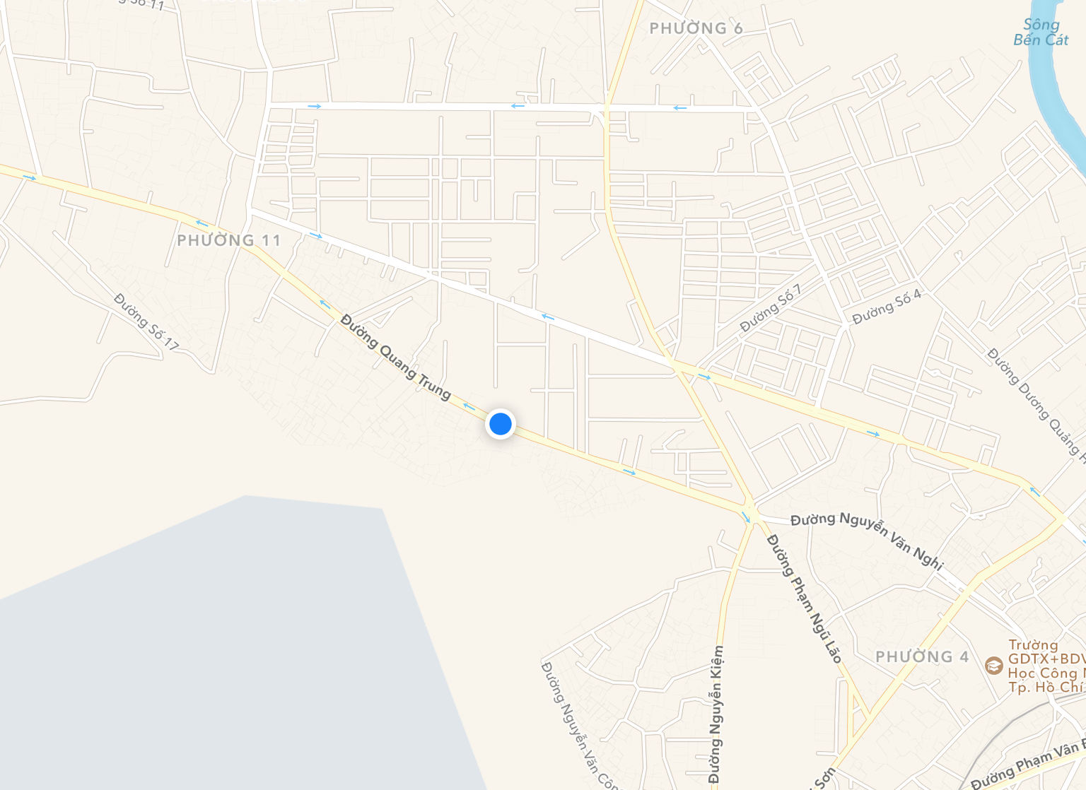
 Nearby algorithm
Filter by District nearby
(10.399303, 104.292832)

Slide 198
 Nearby algorithm
Filter by District nearby
(10.399303, 104.292832)

Slide 199
 Nearby algorithm
Filter by District nearby
(Gò Vấp)

Slide 200
 Nearby algorithm
Filter by District nearby
(Gò Vấp)

Slide 201
 Nearby algorithm
Filter by District nearby
"district_go_vap": { "name": "gò vấp", "nearby": [ "Quận Gò Vấp", "Quận Tân Bình", "Quận Bình Thạnh", "Quận 12" ] },
(Gò Vấp)

Slide 202
 Nearby algorithm
Filter by District nearby
Filter by Haversine
Haversine Formula

Slide 203
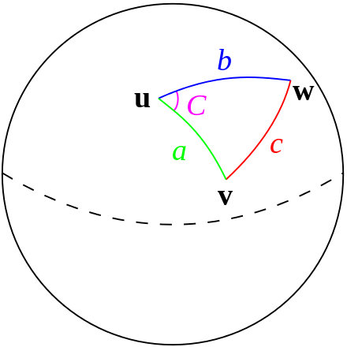
 Nearby algorithm
Filter by District nearby
Filter by Haversine
Haversine

Slide 204
 Nearby algorithm
Filter by District nearby
Filter by Haversine
Haversine
Calculate great – distance between 2 coordinates over the earth’s surface

Slide 205
 Nearby algorithm
Filter by District nearby
Filter by Haversine
d = R x c

Slide 206
 Nearby algorithm
Filter by District nearby
Filter by Haversine
d = R x c
d : distance between 2 coordinates

Slide 207
 Nearby algorithm
Filter by District nearby
Filter by Haversine
d = R x c
d : distance between 2 coordinates
R : radius of the earth

Slide 208
 Nearby algorithm
Filter by District nearby
Filter by Haversine
d = R x c
d : distance between 2 coordinates
R : radius of the earth
c : the angular distance in radians

Slide 209
 Nearby algorithm
Filter by District nearby
Filter by Haversine
d = R x
c
sin²(Δφ/2) + cos φ1 ⋅ cos φ2 ⋅ sin²(Δλ/2)
φ: latitude
λ: longitude
Notes:
Trình bày lại công thưc cho dễ hiểu

Slide 210
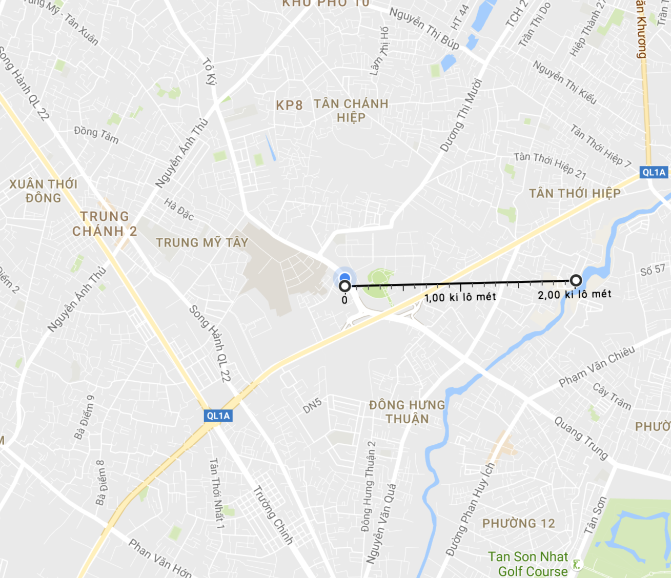

 Nearby algorithm
Filter by District nearby
Filter by Haversine

Slide 211
 Nearby algorithm
Filter by District nearby
Filter by Haversine

Slide 212
 Nearby algorithm
Filter by District nearby
Filter by Haversine
2 km

Slide 213
 Nearby algorithm
Filter by District nearby
Filter by Haversine
2 km

Slide 214
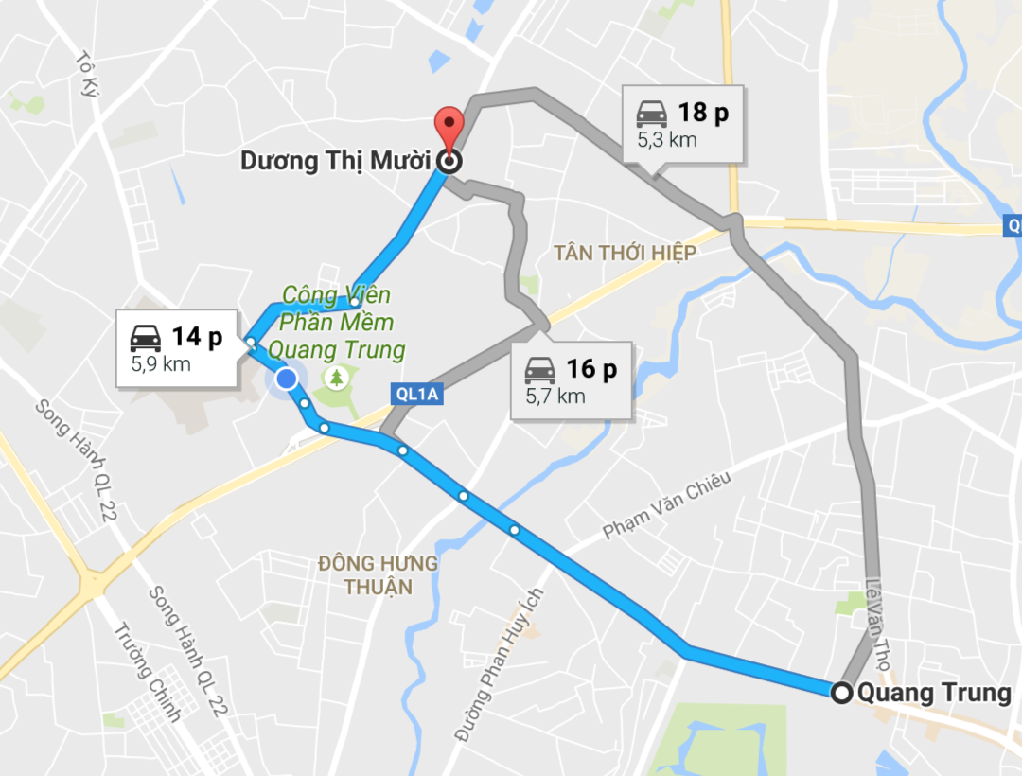
 Nearby algorithm
Filter by District nearby
Filter by Haversine
Filter by Route

Slide 215
 Nearby algorithm
Filter by District nearby
Filter by Haversine
Filter by Route

Slide 216

 Nearby algorithm
Filter by District nearby
Filter by Haversine
Filter by Route
send request
Notes:
Đổi tên bước 3: mình fiter

Slide 217
 Nearby algorithm
Filter by District nearby
Filter by Haversine
Filter by Route
send request
response
Notes:
Đổi tên bước 3: mình fiter

Slide 218
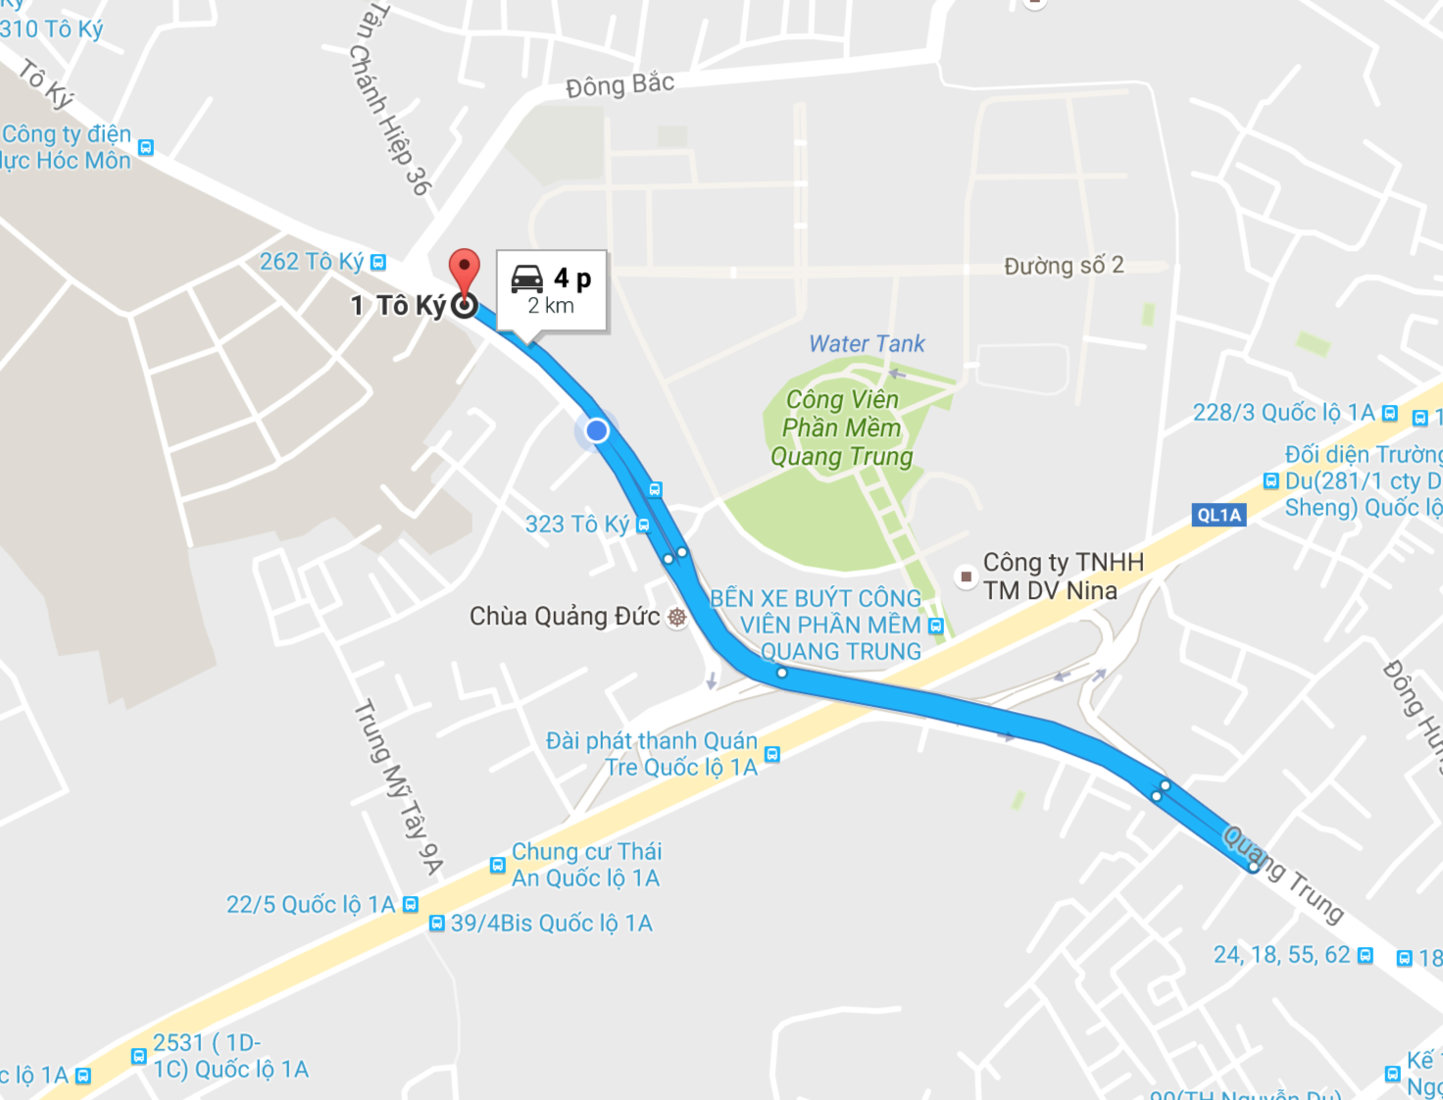
 Nearby algorithm
Filter by District nearby
Filter by Haversine
Filter by Route
2 km

Slide 219
 Nearby algorithm

Slide 220

 Nearby algorithm

Slide 221
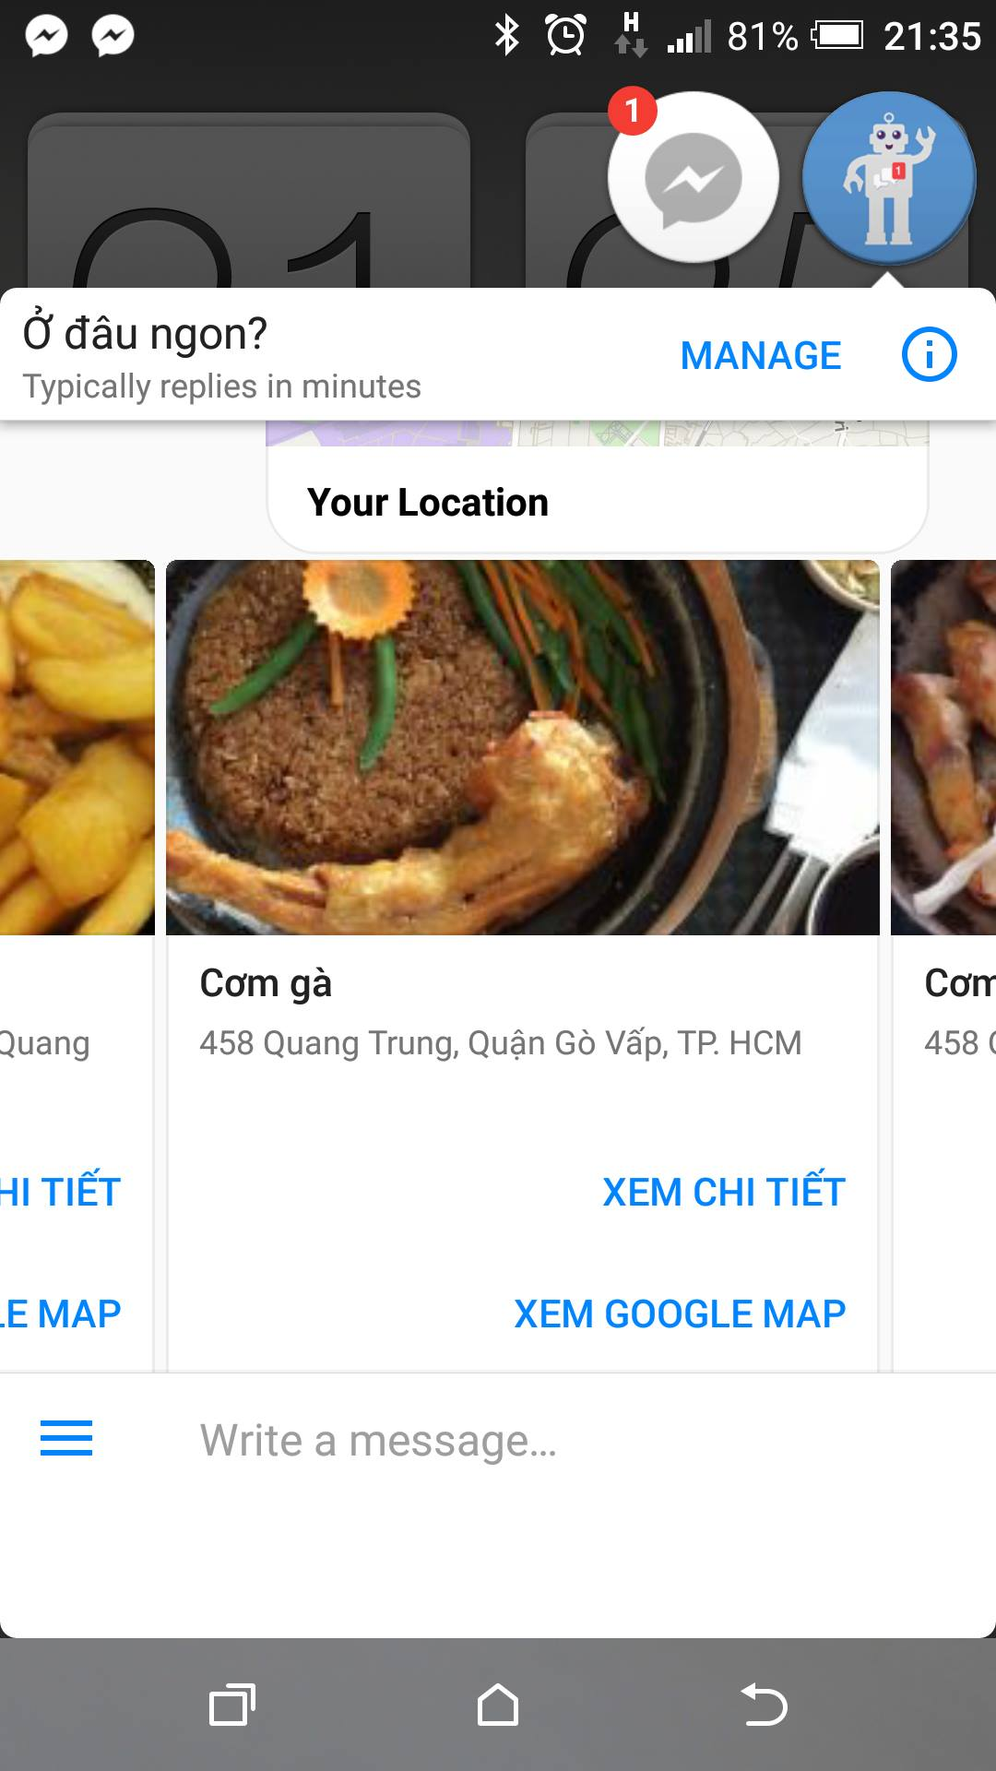
 Nearby algorithm

Slide 222
Demo
Place Suggesting Intelligent Bot
Scenario:
Lan is a facebook user. Lan ask Ở đâu ngon? “Tìm bún bò” and use nearby function of system

Slide 223
Manage Log
Place Suggestion Intelligent Bot

Slide 224
 Manage Log- Scenario
Scenario:
Our system provide service for Company A.

Slide 225
 Manage Log- Scenario
Our Service

Slide 226

 Manage Log- Scenario
Our Service

Slide 227

 Manage Log- Scenario
Our Service
Company A

Slide 228
 Manage Log- Scenario
Company A

Slide 229

 Manage Log- Scenario
Our Service
Company A

Slide 230
 Manage Log- Scenario
Our Service
Company A

Slide 231
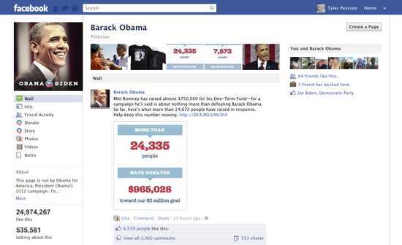
 Manage Log- Scenario
Our Service
Company A

Slide 232
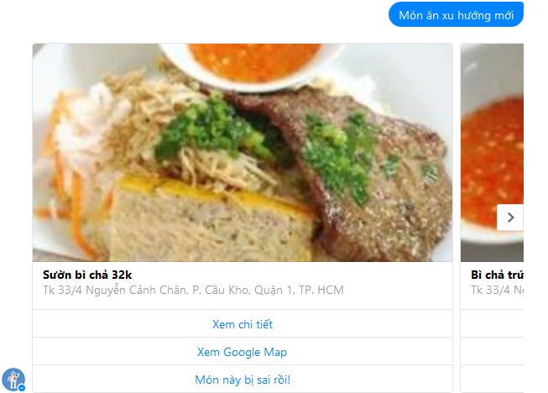
 Manage Log- Scenario

Slide 233

 Manage Log- Scenario

Slide 234
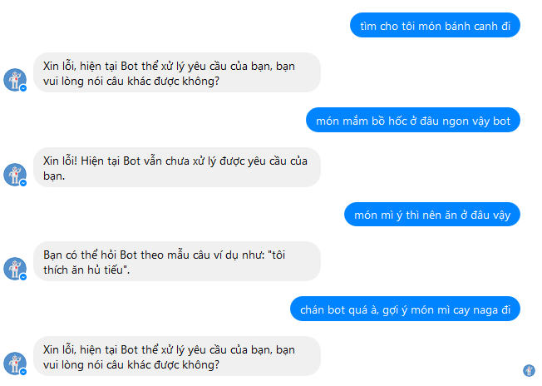
 Manage Log- Scenario

Slide 235
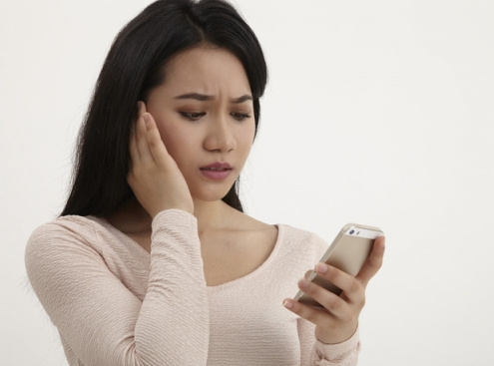
 Manage Log- Scenario

Slide 236
 Manage Log- Scenario
How can company A resolve this problem to meet their customer need?

Slide 237
 Manage Log- Solution
To help company A resolve the problem.
We create 2 main feature

Slide 238

 Manage Log- Solution
Auto write
PSIB Engine
Log

Slide 239
 Manage Log- Solution
Web Admin

Slide 240
 Manage Log- Solution
handle
Log
Web Admin

Slide 241
 Manage Log- Solution
handle
Log
Web Admin
Notes:
Ghi note chữ vào vs mỗi icon có ý nghĩa là ghì

Slide 242

 Manage Log- Solution
handle
Log
Web Admin
Notes:
Ghi note chữ vào vs mỗi icon có ý nghĩa là ghì

Slide 243
 Manage Log- Solution
handle
Log
Web Admin
PSIB Engine
Notes:
Ghi note chữ vào vs mỗi icon có ý nghĩa là ghì

Slide 244
 Manage Log- Solution
handle
Log
Web Admin
PSIB Engine
Notes:
Ghi note chữ vào vs mỗi icon có ý nghĩa là ghì

Slide 245
 Manage Log- Solution
Log
Web Admin
PSIB Engine
Notes:
Ghi note chữ vào vs mỗi icon có ý nghĩa là ghì

Slide 246
 Manage Log- Solution
Log
Web Admin
PSIB Engine
Notes:
Ghi note chữ vào vs mỗi icon có ý nghĩa là ghì

Slide 247
 Manage Log
DEMO 4: Check log, update log and add phrase
Scenario:
Lan is a facebook user. Lan ask Ở đâu ngon? “Tìm takoyaki”

Slide 248
 Manage Log
(1) Ask food
Facebook Messenger
Lan

Slide 249
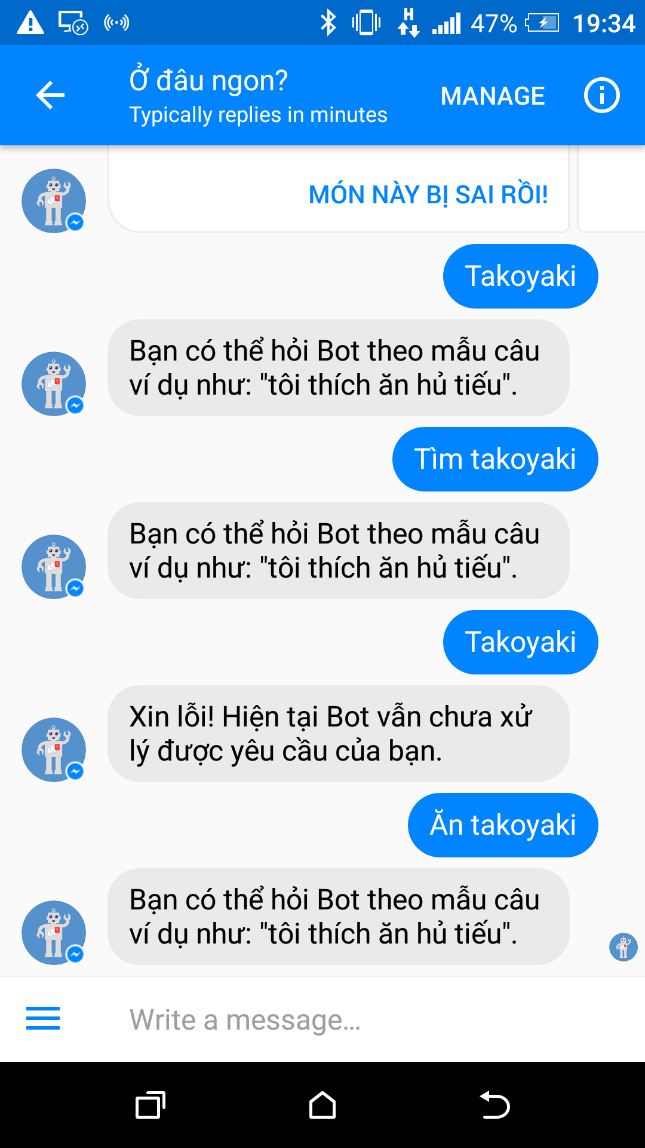
 Manage Log
(1) Ask food
(2) Don’t understand
Facebook Messenger
Lan

Slide 250
 Manage Log
(1) Ask food
(2) Don’t understand
Lan
Timer
Log

Slide 251
 Manage Log
update
Timer
Log
✓ Tracking not understand what user say

Slide 252
 Manage Log
update
Timer
Log
✓ Tracking not understand what user say
✓ Tracking wrong suggested product

Slide 253
 Manage Log
update
Timer
Log
✓ Tracking not understand what user say
✓ Tracking wrong suggested product
✓ Help staff diversify data

Slide 254
 Manage Log
update
Timer
Log
✓ Tracking not understand what user say
✓ Tracking wrong suggested product
✓ Help staff diversify data
✓ Support training

Slide 255
Demo
Place Suggesting Intelligent Bot
Scenario:
Lan is a facebook user. Lan ask Ở đâu ngon? “Tìm takoyaki”

Slide 256
 Algorithm – Sentence compare
Tôi muốn ăn ham bơ gơ ở quận 1
Tôi thích ăn món hamburger ở q1

Slide 257
 Algorithm – Sentence compare
Tôi muốn ăn ham bơ gơ ở quận 1
Tôi thích ăn món hamburger ở q1

Slide 258
 Algorithm – Sentence compare
Normalize
sentence
Tôi muốn ăn ham bơ gơ ở quận 1
Tôi thích ăn món hamburger ở q1

Slide 259
 Algorithm – Sentence compare
Normalize
sentence
Tôi muốn ăn ham bơ gơ ở quận 1
Tôi thích ăn món hamburger ở q1

Slide 260
 Algorithm – Sentence compare
Normalize
sentence
Tôi muốn ăn hamburger ở quận 1
Tôi thích ăn món hamburger ở q1

Slide 261
 Algorithm – Sentence compare
Normalize
sentence
Tôi muốn ăn hamburger ở quận 1
Tôi thích ăn món hamburger ở q1

Slide 262
 Algorithm – Sentence compare
Normalize
sentence
Tôi muốn ăn hamburger ở quận 1
Tôi thích ăn món hamburger ở quận 1

Slide 263
 Algorithm – Sentence compare
Normalize
sentence
Tôi muốn ăn hamburger ở quận 1
Tôi thích ăn món hamburger ở quận 1

Slide 264
 Algorithm – Sentence compare
Normalize
sentence
Choose
sample
Longer sentence | Shorter sentence
Tôi | Tôi
Thích | Muốn
Ăn | Ăn
Món | Hamburger
Hamburger | Ở
Ở | Quận
Quận | 1
1

Slide 265
 Algorithm – Sentence compare
Normalize
sentence
Choose
sample
Count
contains
Length | Longer sentence | Shorter sentence | Count
1 | Tôi | Tôi
2 | Thích | Muốn
3 | Ăn | Ăn
4 | Món | Hamburger
5 | Hamburger | Ở
6 | Ở | Quận
7 | Quận | 1
8 | 1
Notes:
Ghi steps

Slide 266
 Algorithm – Sentence compare
Normalize
sentence
Choose
sample
Count
contains
Length | Longer sentence | Shorter sentence | Count
1 | Tôi | Tôi
2 | Thích | Muốn
3 | Ăn | Ăn
4 | Món | Hamburger
5 | Hamburger | Ở
6 | Ở | Quận
7 | Quận | 1
8 | 1

Slide 267
 Algorithm – Sentence compare
Normalize
sentence
Choose
sample
Count
contains
Length | Longer sentence | Shorter sentence | Count
1 | Tôi | Tôi
2 | Thích | Muốn
3 | Ăn | Ăn
4 | Món | Hamburger
5 | Hamburger | Ở
6 | Ở | Quận
7 | Quận | 1
8 | 1

Slide 268
 Algorithm – Sentence compare
Normalize
sentence
Choose
sample
Count
contains
Length | Longer sentence | Shorter sentence | Count
1 | Tôi | Tôi | 1
2 | Thích | Muốn
3 | Ăn | Ăn
4 | Món | Hamburger
5 | Hamburger | Ở
6 | Ở | Quận
7 | Quận | 1
8 | 1

Slide 269
 Algorithm – Sentence compare
Normalize
sentence
Choose
sample
Count
contains
Length | Longer sentence | Shorter sentence | Count
1 | Tôi | Tôi | 1
2 | Thích | Muốn
3 | Ăn | Ăn
4 | Món | Hamburger
5 | Hamburger | Ở
6 | Ở | Quận
7 | Quận | 1
8 | 1

Slide 270
 Algorithm – Sentence compare
Normalize
sentence
Choose
sample
Count
contains
Length | Longer sentence | Shorter sentence | Count
1 | Tôi | Tôi | 1
2 | Thích | Muốn
3 | Ăn | Ăn
4 | Món | Hamburger
5 | Hamburger | Ở
6 | Ở | Quận
7 | Quận | 1
8 | 1

Slide 271
 Algorithm – Sentence compare
Normalize
sentence
Choose
sample
Count
contains
Length | Longer sentence | Shorter sentence | Count
1 | Tôi | Tôi | 1
2 | Thích | Muốn
3 | Ăn | Ăn
4 | Món | Hamburger
5 | Hamburger | Ở
6 | Ở | Quận
7 | Quận | 1
8 | 1

Slide 272
 Algorithm – Sentence compare
Normalize
sentence
Choose
sample
Count
contains
Length | Longer sentence | Shorter sentence | Count
1 | Tôi | Tôi | 1
2 | Thích | Muốn
3 | Ăn | Ăn
4 | Món | Hamburger
5 | Hamburger | Ở
6 | Ở | Quận
7 | Quận | 1
8 | 1

Slide 273
 Algorithm – Sentence compare
Normalize
sentence
Choose
sample
Count
contains
Length | Longer sentence | Shorter sentence | Count
1 | Tôi | Tôi | 1
2 | Thích | Muốn
3 | Ăn | Ăn
4 | Món | Hamburger
5 | Hamburger | Ở
6 | Ở | Quận
7 | Quận | 1
8 | 1

Slide 274
 Algorithm – Sentence compare
Normalize
sentence
Choose
sample
Count
contains
Length | Longer sentence | Shorter sentence | Count
1 | Tôi | Tôi | 1
2 | Thích | Muốn
3 | Ăn | Ăn
4 | Món | Hamburger
5 | Hamburger | Ở
6 | Ở | Quận
7 | Quận | 1
8 | 1

Slide 275
 Algorithm – Sentence compare
Normalize
sentence
Choose
sample
Count
contains
Length | Longer sentence | Shorter sentence | Count
1 | Tôi | Tôi | 1
2 | Thích | Muốn
3 | Ăn | Ăn
4 | Món | Hamburger
5 | Hamburger | Ở
6 | Ở | Quận
7 | Quận | 1
8 | 1

Slide 276
 Algorithm – Sentence compare
Normalize
sentence
Choose
sample
Count
contains
Length | Longer sentence | Shorter sentence | Count
1 | Tôi | Tôi | 1
2 | Thích | Muốn
3 | Ăn | Ăn
4 | Món | Hamburger
5 | Hamburger | Ở
6 | Ở | Quận
7 | Quận | 1
8 | 1

Slide 277
 Algorithm – Sentence compare
Normalize
sentence
Choose
sample
Count
contains
Length | Longer sentence | Shorter sentence | Count
1 | Tôi | Tôi | 1
2 | Thích | Muốn
3 | Ăn | Ăn
4 | Món | Hamburger
5 | Hamburger | Ở
6 | Ở | Quận
7 | Quận | 1
8 | 1

Slide 278
 Algorithm – Sentence compare
Normalize
sentence
Choose
sample
Count
contains
Length | Longer sentence | Shorter sentence | Count
1 | Tôi | Tôi | 1
2 | Thích | Muốn
3 | Ăn | Ăn
4 | Món | Hamburger
5 | Hamburger | Ở
6 | Ở | Quận
7 | Quận | 1
8 | 1

Slide 279
 Algorithm – Sentence compare
Normalize
sentence
Choose
sample
Count
contains
Length | Longer sentence | Shorter sentence | Count
1 | Tôi | Tôi | 1
2 | Thích | Muốn
3 | Ăn | Ăn
4 | Món | Hamburger
5 | Hamburger | Ở
6 | Ở | Quận
7 | Quận | 1
8 | 1

Slide 280
 Algorithm – Sentence compare
Normalize
sentence
Choose
sample
Count
contains
Length | Longer sentence | Shorter sentence | Count
1 | Tôi | Tôi | 1
2 | Thích | Muốn
3 | Ăn | Ăn
4 | Món | Hamburger
5 | Hamburger | Ở
6 | Ở | Quận
7 | Quận | 1
8 | 1

Slide 281
 Algorithm – Sentence compare
Normalize
sentence
Choose
sample
Count
contains
Length | Longer sentence | Shorter sentence | Count
1 | Tôi | Tôi | 1
2 | Thích | Muốn
3 | Ăn | Ăn
4 | Món | Hamburger
5 | Hamburger | Ở
6 | Ở | Quận
7 | Quận | 1
8 | 1

Slide 282
 Algorithm – Sentence compare
Normalize
sentence
Choose
sample
Count
contains
Length | Longer sentence | Shorter sentence | Count
1 | Tôi | Tôi | 1
2 | Thích | Muốn
3 | Ăn | Ăn
4 | Món | Hamburger
5 | Hamburger | Ở
6 | Ở | Quận
7 | Quận | 1
8 | 1

Slide 283
 Algorithm – Sentence compare
Normalize
sentence
Choose
sample
Count
contains
Length | Longer sentence | Shorter sentence | Count
1 | Tôi | Tôi | 1
2 | Thích | Muốn
3 | Ăn | Ăn | 2
4 | Món | Hamburger
5 | Hamburger | Ở
6 | Ở | Quận
7 | Quận | 1
8 | 1

Slide 284
 Algorithm – Sentence compare
Normalize
sentence
Choose
sample
Count
contains
Length | Longer sentence | Shorter sentence | Count
1 | Tôi | Tôi | 1
2 | Thích | Muốn
3 | Ăn | Ăn | 2
4 | Món | Hamburger
5 | Hamburger | Ở
6 | Ở | Quận
7 | Quận | 1
8 | 1

Slide 285
 Algorithm – Sentence compare
Normalize
sentence
Choose
sample
Count
contains
Length | Longer sentence | Shorter sentence | Count
1 | Tôi | Tôi | 1
2 | Thích | Muốn
3 | Ăn | Ăn | 2
4 | Món | Hamburger
5 | Hamburger | Ở
6 | Ở | Quận
7 | Quận | 1
8 | 1

Slide 286
 Algorithm – Sentence compare
Normalize
sentence
Choose
sample
Count
contains
Length | Longer sentence | Shorter sentence | Count
1 | Tôi | Tôi | 1
2 | Thích | Muốn
3 | Ăn | Ăn | 2
4 | Món | Hamburger
5 | Hamburger | Ở
6 | Ở | Quận
7 | Quận | 1
8 | 1

Slide 287
 Algorithm – Sentence compare
Normalize
sentence
Choose
sample
Count
contains
Length | Longer sentence | Shorter sentence | Count
1 | Tôi | Tôi | 1
2 | Thích | Muốn
3 | Ăn | Ăn | 2
4 | Món | Hamburger
5 | Hamburger | Ở
6 | Ở | Quận
7 | Quận | 1
8 | 1

Slide 288
 Algorithm – Sentence compare
Normalize
sentence
Choose
sample
Count
contains
Length | Longer sentence | Shorter sentence | Count
1 | Tôi | Tôi | 1
2 | Thích | Muốn
3 | Ăn | Ăn | 2
4 | Món | Hamburger | 3
5 | Hamburger | Ở
6 | Ở | Quận
7 | Quận | 1
8 | 1

Slide 289
 Algorithm – Sentence compare
Normalize
sentence
Choose
sample
Count
contains
Length | Longer sentence | Shorter sentence | Count
1 | Tôi | Tôi | 1
2 | Thích | Muốn
3 | Ăn | Ăn | 2
4 | Món | Hamburger | 3
5 | Hamburger | Ở
6 | Ở | Quận
7 | Quận | 1
8 | 1

Slide 290
 Algorithm – Sentence compare
Normalize
sentence
Choose
sample
Count
contains
Length | Longer sentence | Shorter sentence | Count
1 | Tôi | Tôi | 1
2 | Thích | Muốn
3 | Ăn | Ăn | 2
4 | Món | Hamburger | 3
5 | Hamburger | Ở | 4
6 | Ở | Quận
7 | Quận | 1
8 | 1

Slide 291
 Algorithm – Sentence compare
Normalize
sentence
Choose
sample
Count
contains
Length | Longer sentence | Shorter sentence | Count
1 | Tôi | Tôi | 1
2 | Thích | Muốn
3 | Ăn | Ăn | 2
4 | Món | Hamburger | 3
5 | Hamburger | Ở | 4
6 | Ở | Quận
7 | Quận | 1
8 | 1

Slide 292
 Algorithm – Sentence compare
Normalize
sentence
Choose
sample
Count
contains
Length | Longer sentence | Shorter sentence | Count
1 | Tôi | Tôi | 1
2 | Thích | Muốn
3 | Ăn | Ăn | 2
4 | Món | Hamburger | 3
5 | Hamburger | Ở | 4
6 | Ở | Quận | 5
7 | Quận | 1
8 | 1

Slide 293
 Algorithm – Sentence compare
Normalize
sentence
Choose
sample
Count
contains
Length | Longer sentence | Shorter sentence | Count
1 | Tôi | Tôi | 1
2 | Thích | Muốn
3 | Ăn | Ăn | 2
4 | Món | Hamburger | 3
5 | Hamburger | Ở | 4
6 | Ở | Quận | 5
7 | Quận | 1
8 | 1

Slide 294
 Algorithm – Sentence compare
Normalize
sentence
Choose
sample
Count
contains
Length | Longer sentence | Shorter sentence | Count
1 | Tôi | Tôi | 1
2 | Thích | Muốn
3 | Ăn | Ăn | 2
4 | Món | Hamburger | 3
5 | Hamburger | Ở | 4
6 | Ở | Quận | 5
7 | Quận | 1 | 6
8 | 1

Slide 295
 Algorithm – Sentence compare
Normalize
sentence
Choose
sample
Count
contains
Length | Longer sentence | Shorter sentence | Count
1 | Tôi | Tôi | 1
2 | Thích | Muốn
3 | Ăn | Ăn | 2
4 | Món | Hamburger | 3
5 | Hamburger | Ở | 4
6 | Ở | Quận | 5
7 | Quận | 1 | 6
8 | 1

Slide 296
 Algorithm – Sentence compare
Normalize
sentence
Choose
sample
Count
contains
Calculate
contain percent
Length | Longer sentence | Shorter sentence | Count
1 | Tôi | Tôi | 1
2 | Thích | Muốn
3 | Ăn | Ăn | 2
4 | Món | Hamburger | 3
5 | Hamburger | Ở | 4
6 | Ở | Quận | 5
7 | Quận | 1 | 6
8 | 1
containPercent

Slide 297
 Algorithm – Sentence compare
Normalize
sentence
Choose
sample
Count
contains
Calculate
contain percent
Length | Longer sentence | Shorter sentence | Count
1 | Tôi | Tôi | 1
2 | Thích | Muốn
3 | Ăn | Ăn | 2
4 | Món | Hamburger | 3
5 | Hamburger | Ở | 4
6 | Ở | Quận | 5
7 | Quận | 1 | 6
8 | 1
containPercent$=\frac{numOfContains}{}$

Slide 298
 Algorithm – Sentence compare
Normalize
sentence
Choose
sample
Count
contains
Calculate
contain percent
Length | Longer sentence | Shorter sentence | Count
1 | Tôi | Tôi | 1
2 | Thích | Muốn
3 | Ăn | Ăn | 2
4 | Món | Hamburger | 3
5 | Hamburger | Ở | 4
6 | Ở | Quận | 5
7 | Quận | 1 | 6
8 | 1
containPercent$=\frac{numOfContains}{longerSenLength}$

Slide 299
 Algorithm – Sentence compare
Normalize
sentence
Choose
sample
Count
contains
Calculate
contain percent
Length | Longer sentence | Shorter sentence | Count
1 | Tôi | Tôi | 1
2 | Thích | Muốn
3 | Ăn | Ăn | 2
4 | Món | Hamburger | 3
5 | Hamburger | Ở | 4
6 | Ở | Quận | 5
7 | Quận | 1 | 6
8 | 1
containPercent$=\frac{numOfContains}{longerSenLength}=\frac{}{}$

Slide 300
 Algorithm – Sentence compare
Normalize
sentence
Choose
sample
Count
contains
Calculate
contain percent
Length | Longer sentence | Shorter sentence | Count
1 | Tôi | Tôi | 1
2 | Thích | Muốn
3 | Ăn | Ăn | 2
4 | Món | Hamburger | 3
5 | Hamburger | Ở | 4
6 | Ở | Quận | 5
7 | Quận | 1 | 6
8 | 1
containPercent$=\frac{numOfContains}{longerSenLength}=\frac{}{}$

Slide 301
 Algorithm – Sentence compare
Normalize
sentence
Choose
sample
Count
contains
Calculate
contain percent
Length | Longer sentence | Shorter sentence | Count
1 | Tôi | Tôi | 1
2 | Thích | Muốn
3 | Ăn | Ăn | 2
4 | Món | Hamburger | 3
5 | Hamburger | Ở | 4
6 | Ở | Quận | 5
7 | Quận | 1 | 6
8 | 1
containPercent$=\frac{numOfContains}{longerSenLength}=\frac{6}{}$

Slide 302
 Algorithm – Sentence compare
Normalize
sentence
Choose
sample
Count
contains
Calculate
contain percent
Length | Longer sentence | Shorter sentence | Count
1 | Tôi | Tôi | 1
2 | Thích | Muốn
3 | Ăn | Ăn | 2
4 | Món | Hamburger | 3
5 | Hamburger | Ở | 4
6 | Ở | Quận | 5
7 | Quận | 1 | 6
8 | 1
containPercent$=\frac{numOfContains}{longerSenLength}=\frac{6}{}$

Slide 303
 Algorithm – Sentence compare
Normalize
sentence
Choose
sample
Count
contains
Calculate
contain percent
Length | Longer sentence | Shorter sentence | Count
1 | Tôi | Tôi | 1
2 | Thích | Muốn
3 | Ăn | Ăn | 2
4 | Món | Hamburger | 3
5 | Hamburger | Ở | 4
6 | Ở | Quận | 5
7 | Quận | 1 | 6
8 | 1
containPercent$=\frac{numOfContains}{longerSenLength}=\frac{6}{8}=$

Slide 304
 Algorithm – Sentence compare
Normalize
sentence
Choose
sample
Count
contains
Calculate
contain percent
Length | Longer sentence | Shorter sentence | Count
1 | Tôi | Tôi | 1
2 | Thích | Muốn
3 | Ăn | Ăn | 2
4 | Món | Hamburger | 3
5 | Hamburger | Ở | 4
6 | Ở | Quận | 5
7 | Quận | 1 | 6
8 | 1
containPercent$=\frac{numOfContains}{longerSenLength}=\frac{6}{8}=0.75$

Slide 305
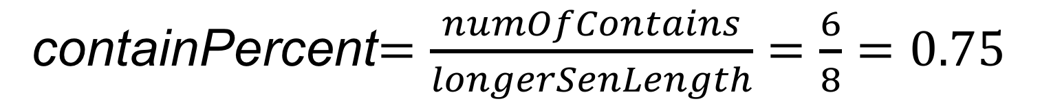
 Algorithm – Sentence compare
Length | Longer sentence | Shorter sentence | Count
1 | Tôi | Tôi | 1
2 | Thích | Muốn
3 | Ăn | Ăn | 2
4 | Món | Hamburger | 3
5 | Hamburger | Ở | 4
6 | Ở | Quận | 5
7 | Quận | 1 | 6
8 | 1
%
0.1
0.2
0.3
0.4
0.5
0.6
0.7
0.8
0.9
1.0
containPercent$=\frac{numOfContains}{longerSenLength}=\frac{6}{8}=0.75$

Slide 306
 Algorithm – Sentence compare
Length | Longer sentence | Shorter sentence | Count
1 | Tôi | Tôi | 1
2 | Thích | Muốn
3 | Ăn | Ăn | 2
4 | Món | Hamburger | 3
5 | Hamburger | Ở | 4
6 | Ở | Quận | 5
7 | Quận | 1 | 6
8 | 1
%
0.1
0.2
0.3
0.4
0.5
0.6
0.7
0.8
0.9
1.0
containPercent$=\frac{numOfContains}{longerSenLength}=\frac{6}{8}=0.75$

Slide 307
 Algorithm – Sentence compare
Length | Longer sentence | Shorter sentence | Count
1 | Tôi | Tôi | 1
2 | Thích | Muốn
3 | Ăn | Ăn | 2
4 | Món | Hamburger | 3
5 | Hamburger | Ở | 4
6 | Ở | Quận | 5
7 | Quận | 1 | 6
8 | 1
%
0.1
0.2
0.3
0.4
0.5
0.6
0.7
0.8
0.9
1.0
containPercent$=\frac{numOfContains}{longerSenLength}=\frac{6}{8}=0.75$

Slide 308
 Algorithm – Sentence compare
Length | Longer sentence | Shorter sentence | Count
1 | Tôi | Tôi | 1
2 | Thích | Muốn
3 | Ăn | Ăn | 2
4 | Món | Hamburger | 3
5 | Hamburger | Ở | 4
6 | Ở | Quận | 5
7 | Quận | 1 | 6
8 | 1
%
0.1
0.2
0.3
0.4
0.5
0.6
0.7
0.8
0.9
1.0
containPercent$=\frac{numOfContains}{longerSenLength}=\frac{6}{8}=0.75$

Slide 309
 Algorithm – Sentence compare
Length | Longer sentence | Shorter sentence | Count
1 | Tôi | Tôi | 1
2 | Thích | Muốn
3 | Ăn | Ăn | 2
4 | Món | Hamburger | 3
5 | Hamburger | Ở | 4
6 | Ở | Quận | 5
7 | Quận | 1 | 6
8 | 1
%
0.1
0.2
0.3
0.4
0.5
0.6
0.7
0.8
0.9
1.0
containPercent$=\frac{numOfContains}{longerSenLength}=\frac{6}{8}=0.75$

Slide 310
 Algorithm – Sentence compare
Length | Longer sentence | Shorter sentence | Count
1 | Tôi | Tôi | 1
2 | Thích | Muốn
3 | Ăn | Ăn | 2
4 | Món | Hamburger | 3
5 | Hamburger | Ở | 4
6 | Ở | Quận | 5
7 | Quận | 1 | 6
8 | 1
%
0.1
0.2
0.3
0.4
0.5
0.6
0.7
0.8
0.9
1.0
containPercent$=\frac{numOfContains}{longerSenLength}=\frac{6}{8}=0.75$

Slide 311
 Algorithm – Sentence compare
Length | Longer sentence | Shorter sentence | Count
1 | Tôi | Tôi | 1
2 | Thích | Muốn
3 | Ăn | Ăn | 2
4 | Món | Hamburger | 3
5 | Hamburger | Ở | 4
6 | Ở | Quận | 5
7 | Quận | 1 | 6
8 | 1
%
0.1
0.2
0.3
0.4
0.5
0.6
0.7
0.8
0.9
1.0
containPercent$=\frac{numOfContains}{longerSenLength}=\frac{6}{8}=0.75$

Slide 312
 Algorithm – Sentence compare
Length | Longer sentence | Shorter sentence | Count
1 | Tôi | Tôi | 1
2 | Thích | Muốn
3 | Ăn | Ăn | 2
4 | Món | Hamburger | 3
5 | Hamburger | Ở | 4
6 | Ở | Quận | 5
7 | Quận | 1 | 6
8 | 1
%
0.1
0.2
0.3
0.4
0.5
0.6
0.7
0.8
0.9
1.0
containPercent$=\frac{numOfContains}{longerSenLength}=\frac{6}{8}=0.75$

Slide 313
 Algorithm – Sentence compare
Length | Longer sentence | Shorter sentence | Count
1 | Tôi | Tôi | 1
2 | Thích | Muốn
3 | Ăn | Ăn | 2
4 | Món | Hamburger | 3
5 | Hamburger | Ở | 4
6 | Ở | Quận | 5
7 | Quận | 1 | 6
8 | 1
%
0.1
0.2
0.3
0.4
0.5
0.6
0.7
0.8
0.9
1.0
containPercent$=\frac{numOfContains}{longerSenLength}=\frac{6}{8}=0.75$

Slide 314
 Algorithm – Sentence compare
~
~
Tôi muốn ăn ham bơ gơ ở q1
Tôi thích ăn món hamburger ở quận 1

Slide 315
 Manage Log
(1) Ask product
(2) Send request
Facebook Users
Facebook Messenger
(3) Analyze user say
PSIB Engine
(1) train
Web Training

Slide 316
 Manage Log
(1) Ask product
(2) Send request
Facebook Users
Facebook Messenger
(3) Analyze user say
PSIB Engine
(1) train
Log
Web Training

Slide 317
 Manage Log
(1) Ask product
(2) Send request
Facebook Users
Facebook Messenger
(3) Analyze user say
PSIB Engine
(4) Write log
(1) train
Log
Web Training

Slide 318
 Manage Log
(1) Ask product
(2) Send request
Facebook Users
Facebook Messenger
(3) Analyze user say
PSIB Engine
(4) Write log
(1) train
(2) Manage Log
Log
Web Training

Slide 319
 Additional Features
To enhance the user experience we create:
The Persistent Menu is a menu that is always available to the user. This menu should contain top-level actions that users can enact at any point.

Slide 320
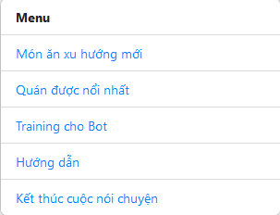
 Additional Features
Persistent Menu
Notes:
Phải ghi chú thích trên slide

Slide 321
 Additional Features
Persistent Menu
Suggesting food and restaurant has high rating
Notes:
Phải ghi chú thích trên slide

Slide 322
 Additional Features
Persistent Menu
Suggesting food and restaurant has high rating
Support training bot for more intelligent

Slide 323
 Additional Features
Persistent Menu
Suggesting food and restaurant has high rating
Support training bot for more intelligent
Manual shortcuts

Slide 324
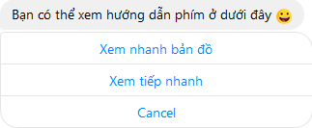
 Additional Features
Shortcuts

Slide 325
 Additional Features
Shortcuts

Slide 326
Demo
Place Suggesting Intelligent Bot
Scenario:
Lan just know about “Ở đâu ngon” chat bot. She takes around to view all features of it.

Slide 327
 Our Features
PSIB
Facebook Users
Staffs

Slide 328
 Our Features
PSIB
Facebook Users
Staffs

Slide 329
 Our Features
PSIB
Facebook Users
Staffs
PSIB Engine
+ Handle user question
+ Save user info
+ Suggest nearby place
+ Analyze most search food

Slide 330
 Our Features
PSIB
Facebook Users
Staffs
PSIB Engine
+ Handle user question
+ Save user info
+ Suggest nearby place
+ Analyze most search food

Slide 331
 Our Features
PSIB
Facebook Users
Staffs
PSIB Engine
+ Handle user question
+ Save user info
+ Suggest nearby place
+ Analyze most search food

Slide 332
 Our Features
PSIB
Facebook Users
Staffs
Timer
+ Parse data
+ Synchronize between API and database
+ Generate Synonym for data and api
PSIB Engine
+ Handle user question
+ Save user info
+ Suggest nearby palce
+ Analyze most search food

Slide 333
 Our Features
PSIB
Facebook Users
Staffs
Timer
+ Parse data
+ Synchronize between API and database
+ Generate Synonym for data and api
PSIB Engine
+ Handle user question
+ Save user info
+ Suggest nearby place
+ Analyze most search food

Slide 334
 Our Features
PSIB
Facebook Users
Staffs
Timer
+ Parse data
+ Synchronize between API and database
+ Generate Synonym for data and api
PSIB Engine
+ Handle user question
+ Save user info
+ Suggest nearby place
+ Analyze most search food

Slide 335
 Our Features
PSIB
Facebook Users
Staffs
Timer
+ Parse data
+ Synchronize between API and database
+ Generate Synonym for data and api
PSIB Engine
+ Handle user question
+ Save user info
+ Suggest nearby place
+ Analyze most search food
Web application
+ Configure sheduler
+ Train bot
+ Manage Log
+ Manage Information

Slide 336
 Our Features
Demo
Not demo
✓ Food suggestion
✓ Crawl data
✓ Training bot
✓ Manage Food
✓ Diversified data
✓ Manage Synonym
✓ Suggest nearby
✓ Config timer
✓ Manage Log
✓ Add phrases
✓ Persistent menu

Slide 337
Advantage/ Disadvantage
Place Suggesting Intelligent Bot

Slide 338
 Advantage
✓ Bot can be more intelligent by process of training.
Notes:
Cần mô hình expanded

Slide 339
 Advantage
✓ Bot can be more intelligent by process of training.
✓ Our system can be expanded and applied in many different businesses.
Notes:
Cần mô hình expanded

Slide 340
 Advantage
✓ Bot can be more intelligent by process of training.
✓ Our system can be expanded and applied in many different businesses.
✓ Save times and cost.
Notes:
Cần mô hình expanded

Slide 341
 Disadvantage
✘ New technology, recognize user behavior

Slide 342
 Disadvantage
✘ New technology, recognize user behavior
✘ Need time to training for staff to using the system.

Slide 343
 Disadvantage
✘ New technology, recognize user behavior
✘ Need time to training for staff to using the system.
✘ Only support users from social network.

Slide 344
 Disadvantage
✘ New technology, recognize user behavior
✘ Need time to training for staff to using the system.
✘ Only support users from social network.
✘ Hard to change the behavior of users.

Slide 345
 Disadvantage
✘ New technology, recognize user behavior
✘ Need time to training for staff to using the system.
✘ Only support users from social network.
✘ Hard to change the behavior of users.
✘ Facebook Messenger Platform and Api.ai are new technology, so it still not stable.

Slide 346
FUTURE PLAN
Place SuggestiNG Intelligent Bot

Slide 347
 Future plan

Slide 348
 Future plan
Facebook Messenger

Slide 349

 Future plan
Facebook Messenger
Skype

Slide 350

 Future plan
Facebook Messenger
Skype
Slack
Notes:
Ghi chữ icon vào (sơ đồ trên kia cũng ghi thêm chữ vào nữa)

Slide 351
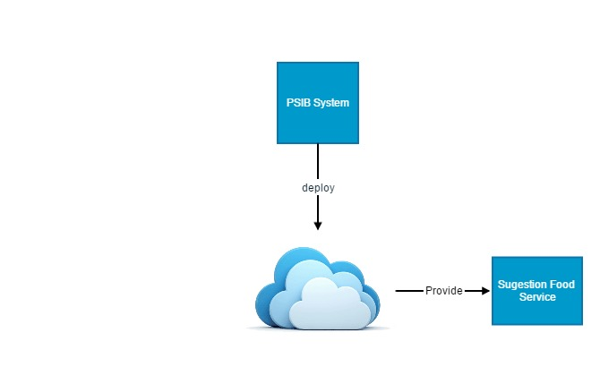
 Future plan

Slide 352
 Future plan
Product Component
FacebookUser
Synonym
Product
Lexical Category
Phrase
Staff
Street
District

Slide 353
 Future plan
Product Component
FacebookUser
Synonym
Product
Lexical Category
Phrase
Staff
Street
District

Slide 354
 Future plan
Common Component
Product Component
FacebookUser
Product
Synonym
Street
District
Lexical Category
Phrase
Staff

Slide 355
 Future plan
Pizza
Clothes
Mobile
Market

Slide 356
 Future plan
Pizza
Clothes
Mobile
Market

Slide 357
 Future plan
Pizza
Clothes
Mobile
Market

Slide 358
 Future plan
Pizza
Clothes
Mobile
Market

Slide 359
 Future plan
Note:
A store
Pizza
Clothes
Mobile
Market

Slide 360
 Future plan
Center Server
Common Component
Pizza
Component
Clothes
Component
Mobile
Component
Market
Component

Slide 361
 Future plan
Center Server

Slide 362
 Future plan
Deploy
Center Server

Slide 363

 Future plan
Deploy
Center Server

Slide 364
 Future plan
Deploy
Center Server

Slide 365
 Future plan
Deploy
Center Server

Slide 366
 Future plan
Note:
PISB Instance
Deploy
Center Server

Slide 367
 Future plan
FacebookUser
UserId
firstName
lastName
gender
locale

Slide 368
 Future plan
FacebookUser
UserId
firstName
lastName
gender
locale
✓ Use to analyze user hobbies and suggest product follow their hobbies

Slide 369
 Future plan
FacebookUser
UserId
firstName
lastName
gender
locale
✓ Use to analyze user hobbies and suggest product follow their hobbies
✓ Marketing products

Slide 370
Thanks for your attention! Q&A

